Slide 1
WHAM runs to-date

Slide 2
Bridge runs
Run 1: MT 2021 but turn off all indices but NEFSC spring BTS and Rec CPA (Tim showed this a few weeks ago)
Run 2: Update fishing fleets from trawl/nontrawl to commercial/recreational
Run 3: Update NEFSC Spring BTS and Rec CPA with new time series

Slide 3
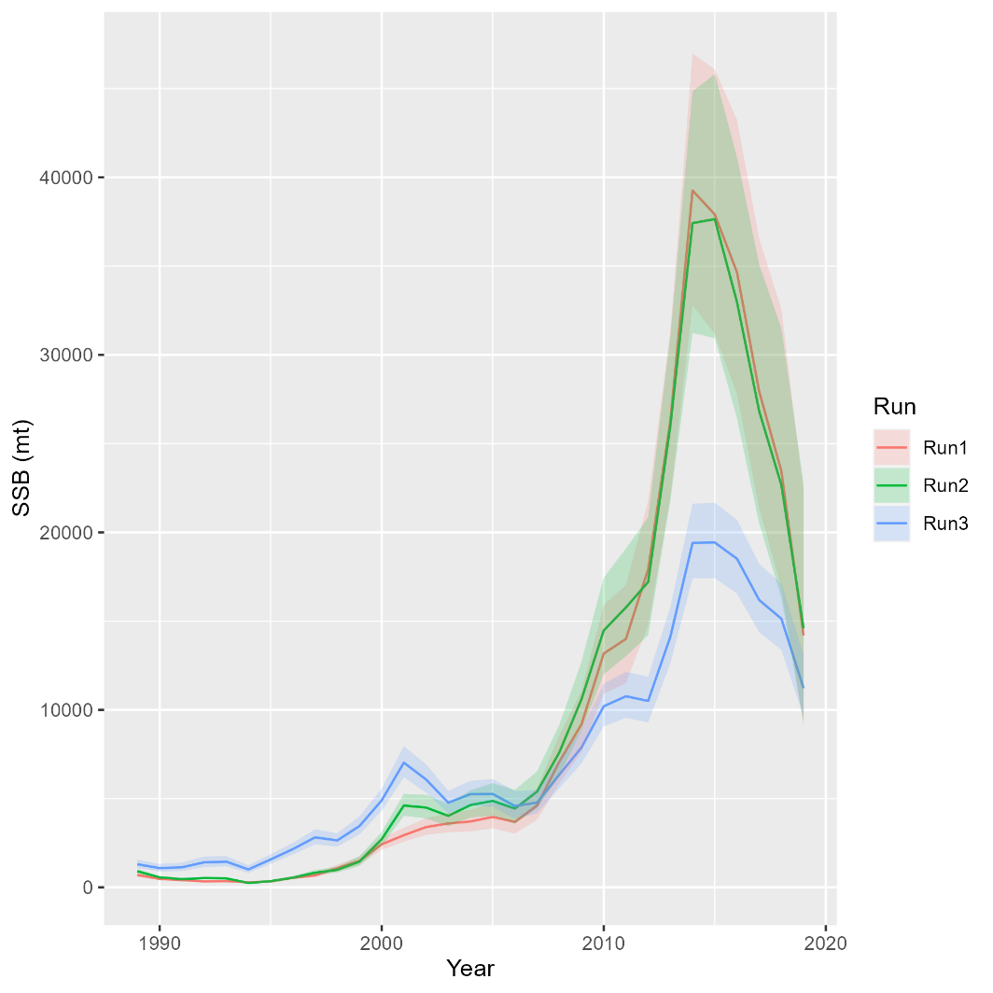
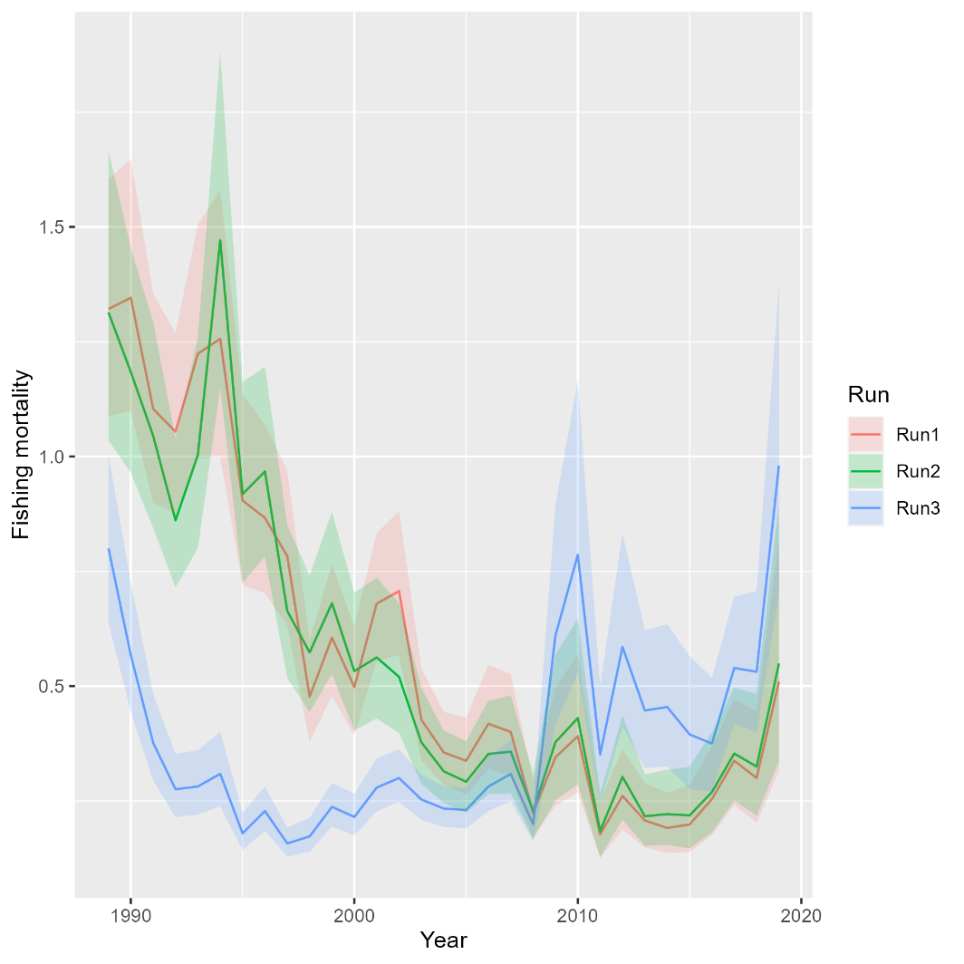
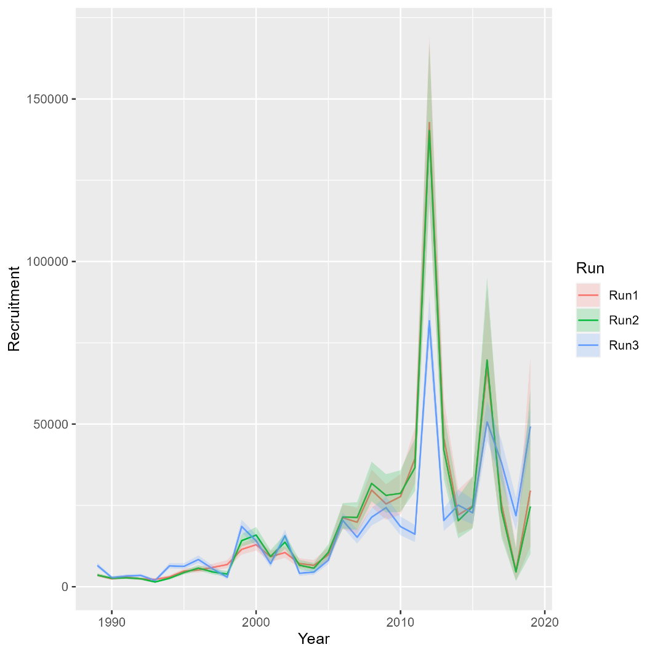
Runs 1-3: updating fishing fleets, NEFSC BTS, Rec CPA
Mohn’s rho
Run | F | SSB | Rect
1 | 1.472 | -0.608 | -0.628
2 | 1.371 | -0.568 | -0.634
3 | 0.777 | -0.351 | -0.153
NOTE: The updated Rec CPA run (Run 3) used the empirical CVs (which are unrealistically small and were not used in the final RT run). Thus, the influence of updates to the Rec CPA index are over-estimated in Run 3.
North

Slide 4
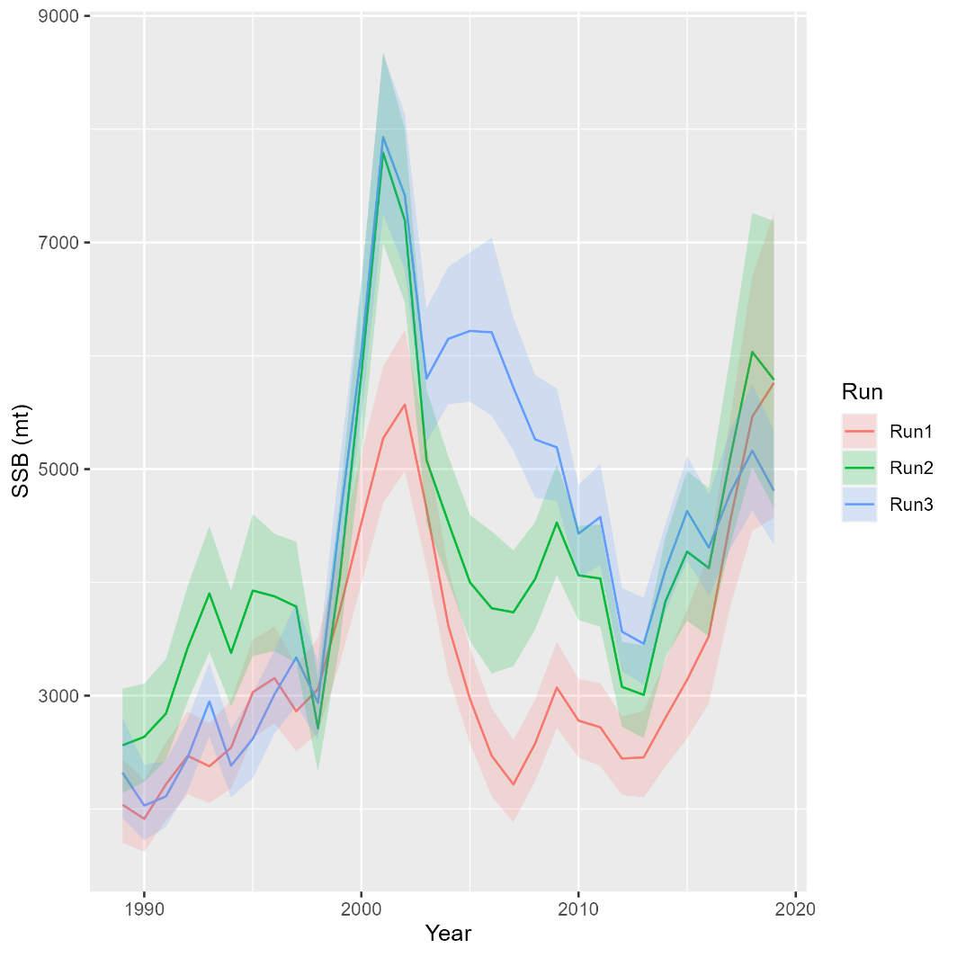
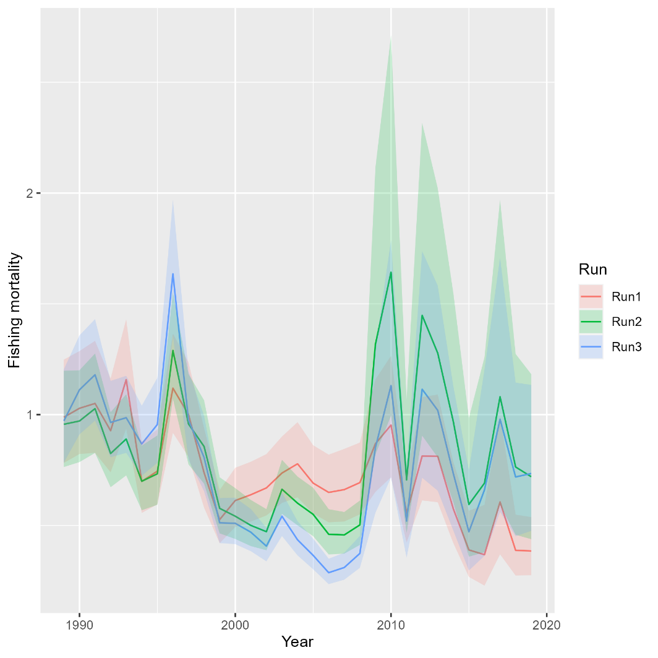
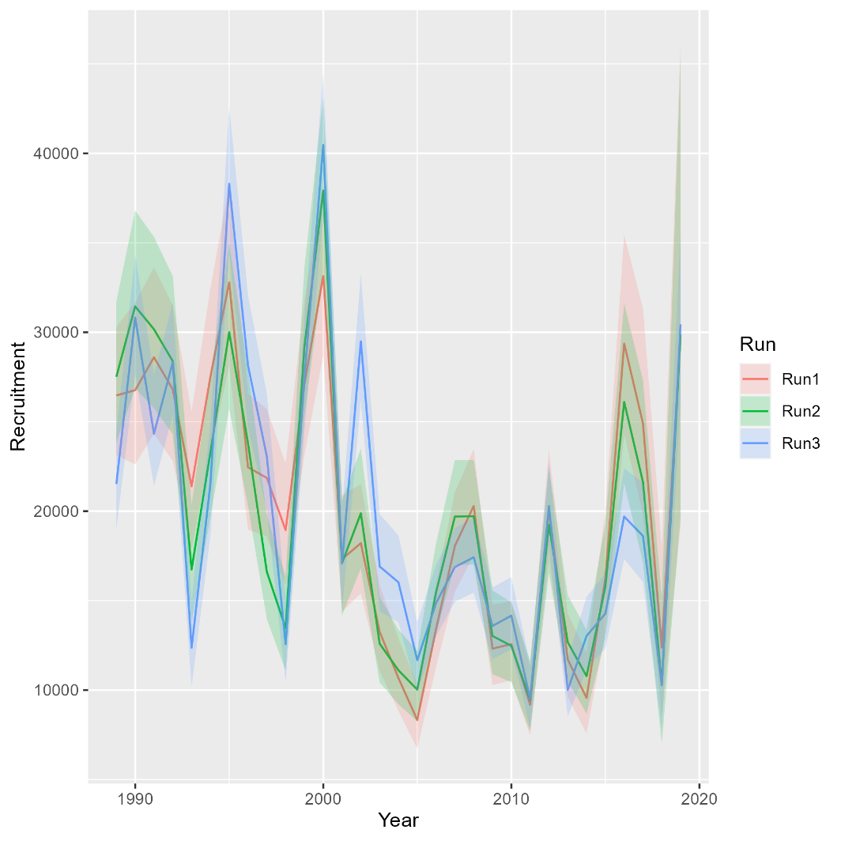
Runs 1-3: updating fishing fleets, NEFSC BTS, Rec CPA
Mohn’s rho
Run | F | SSB | Rect
1 | -0.147 | 0.166 | 0.389
2 | -0.002 | 0.057 | 0.161
3 | -0.087 | 0.074 | 0.05
NOTE: The updated Rec CPA run (Run 3) used the empirical CVs (which are unrealistically small and were not used in the final RT run). Thus, the influence of updates to the Rec CPA index are over-estimated in Run 3.
South

Slide 5
Bridge runs
Run 1: MT 2021 but turn off all indices but NEFSC spring BTS and Rec CPA (Tim showed this a few weeks ago)
Run 2: Update fishing fleets from trawl/nontrawl to commercial/recreational
Run 3: Update NEFSC Spring BTS and Rec CPA with new time series
Run 4: Add 2020-2021 data

Slide 6
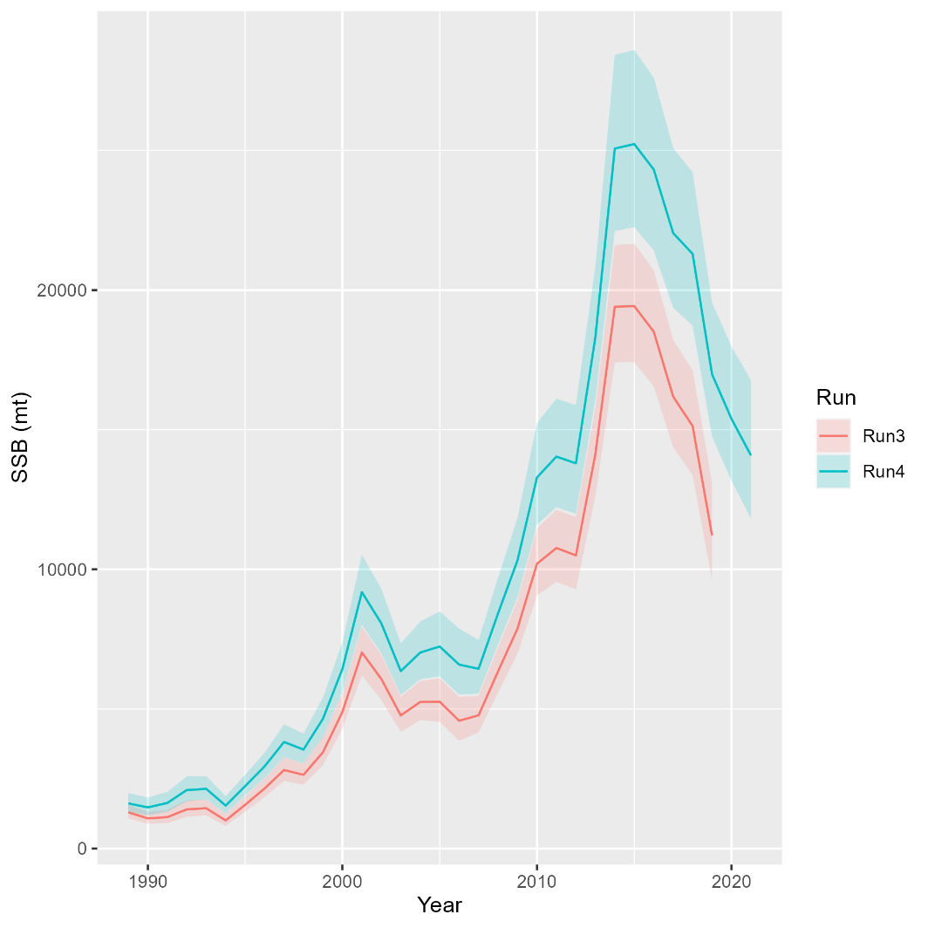
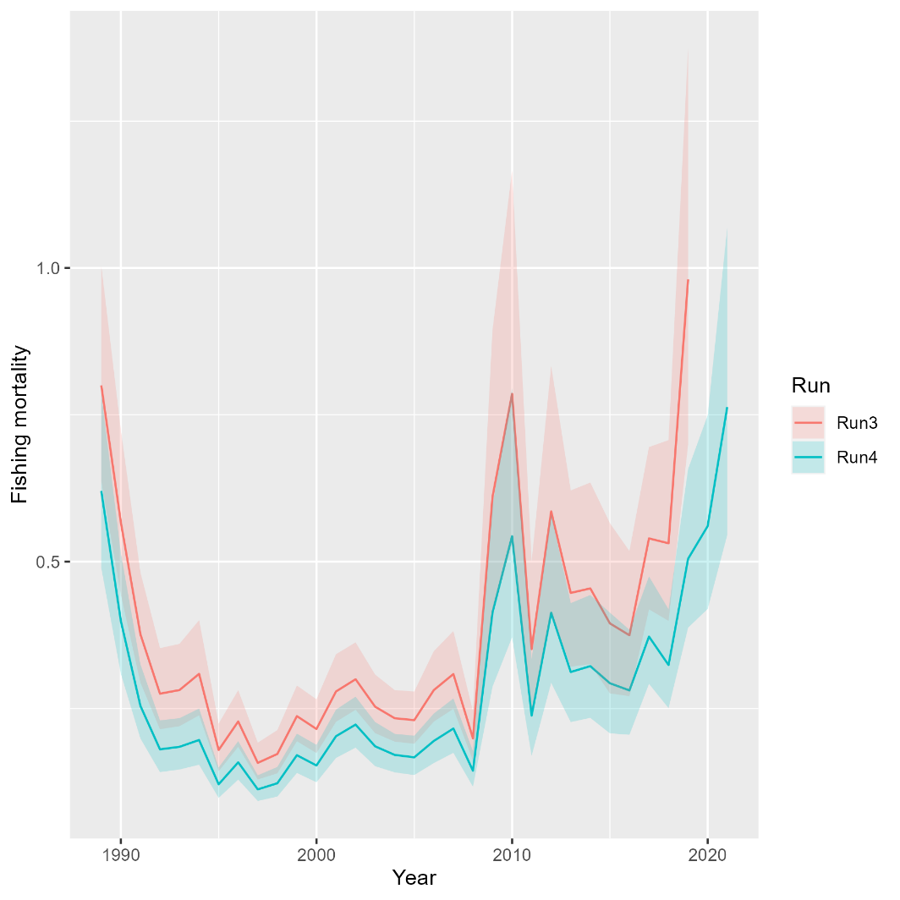
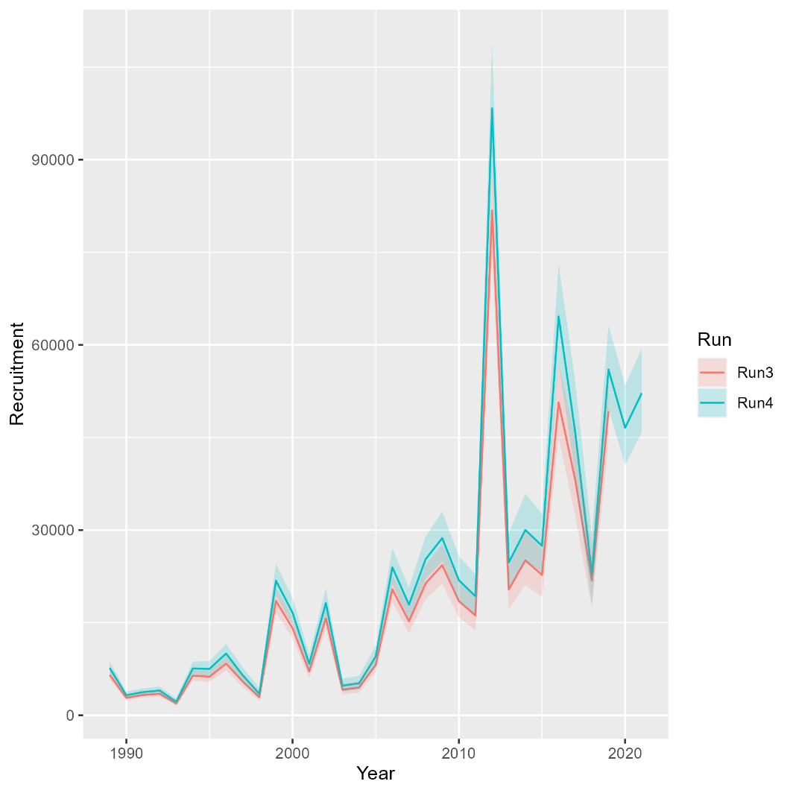
Runs 3-4: Adding 2020-2021
Mohn’s rho
Run | F | SSB | Rect
3 | 0.777 | -0.351 | -0.153
4 | 1.294 | -0.431 | -0.165
North

Slide 7
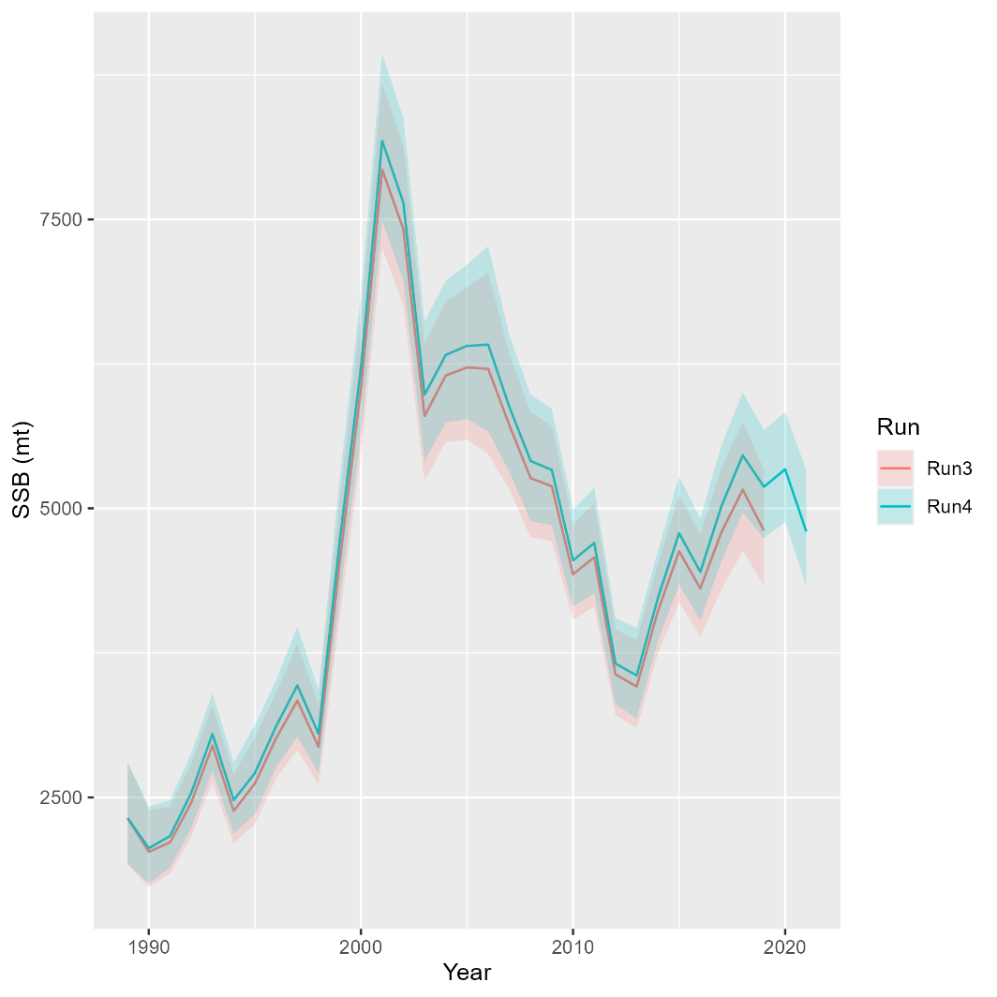
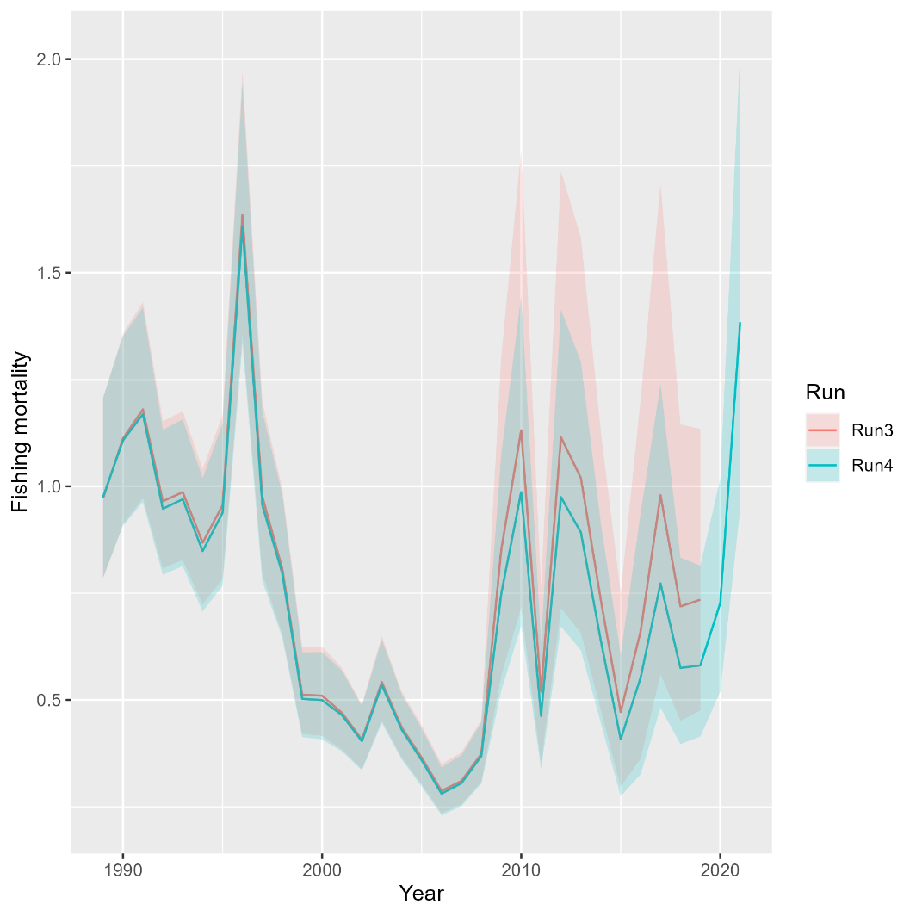
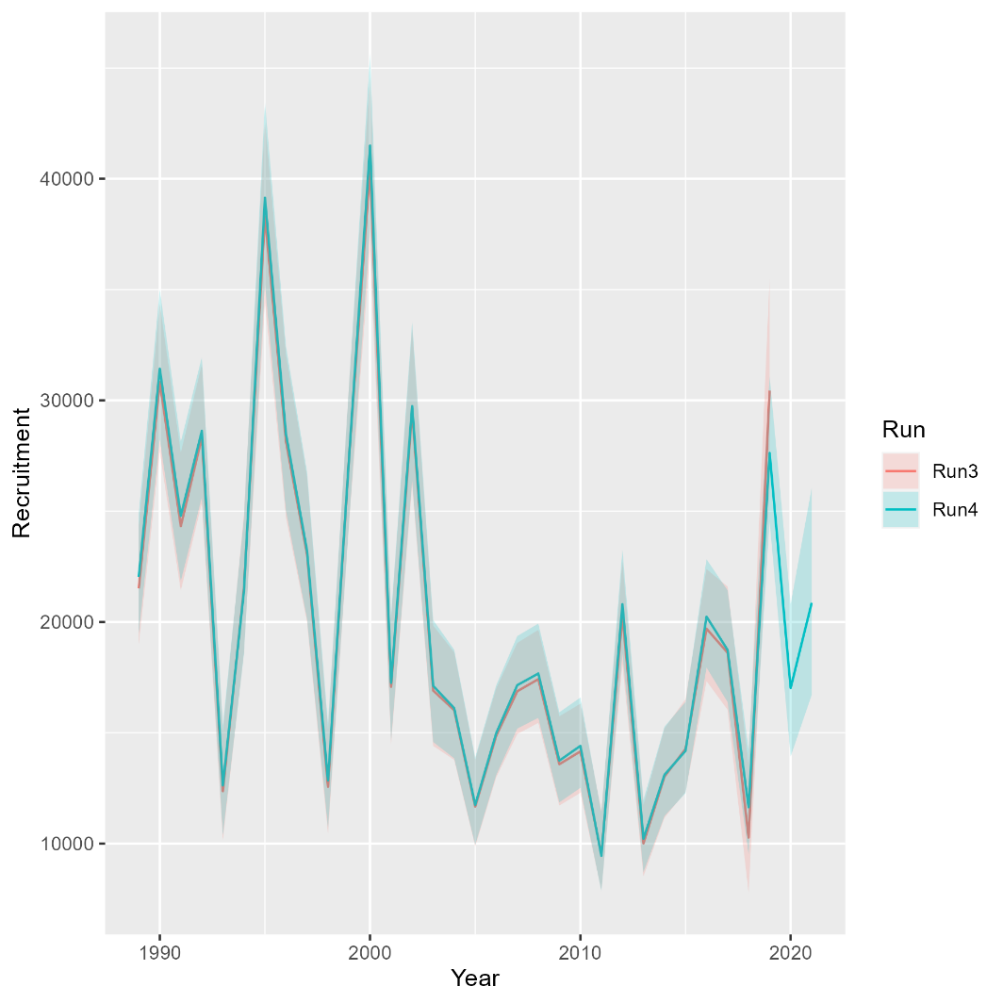
Runs 3-4: Adding 2020-2021
Mohn’s rho
Run | F | SSB | Rect
3 | -0.087 | 0.074 | 0.05
4 | 0.107 | -0.017 | 0.005
South

Slide 8
Bridge runs
Run 1: MT 2021 but turn off all indices but NEFSC spring BTS and Rec CPA (Tim showed this a few weeks ago)
Run 2: Update fishing fleets from trawl/nontrawl to commercial/recreational
Run 3: Update NEFSC Spring BTS and Rec CPA with new time series
Run 4: Add 2020-2021 data
Run 5: Update maturity time series
Run 6: Add updated NEAMAP Indices
Run 7: Add updated state indices

Slide 9
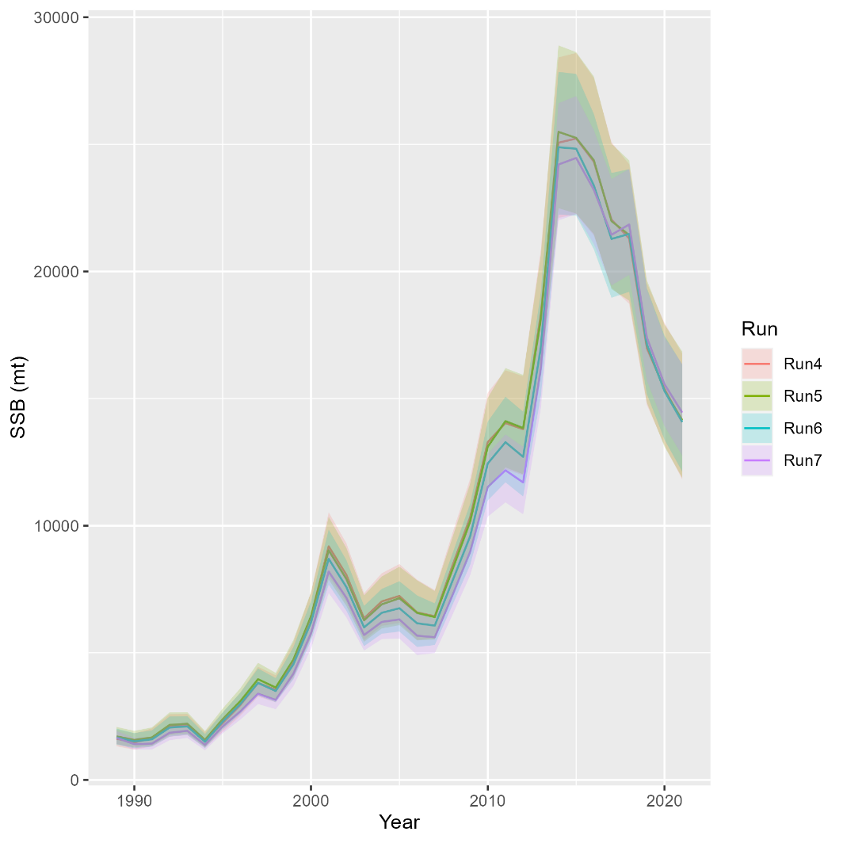
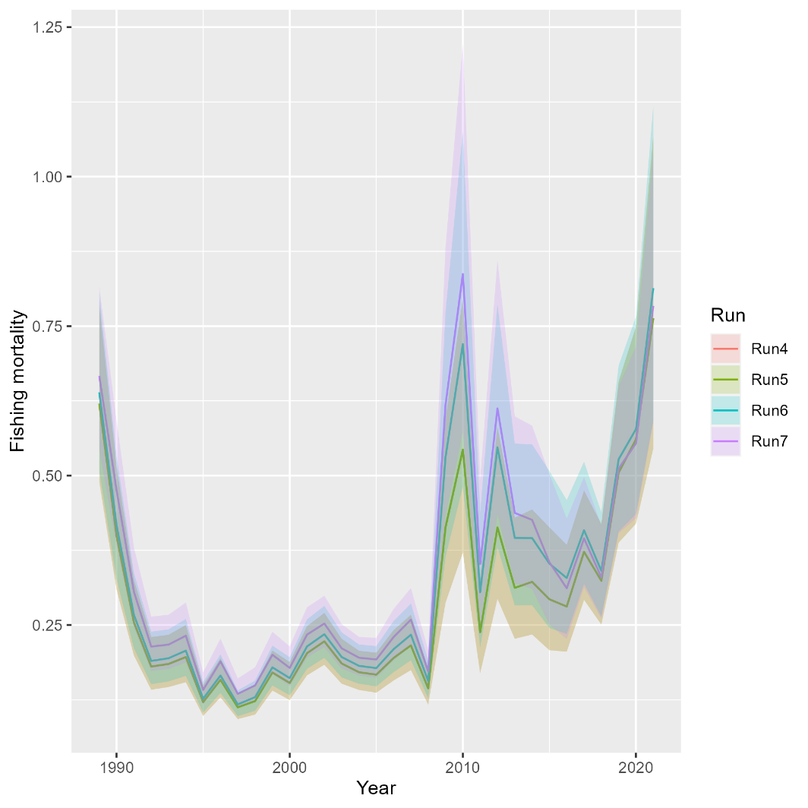
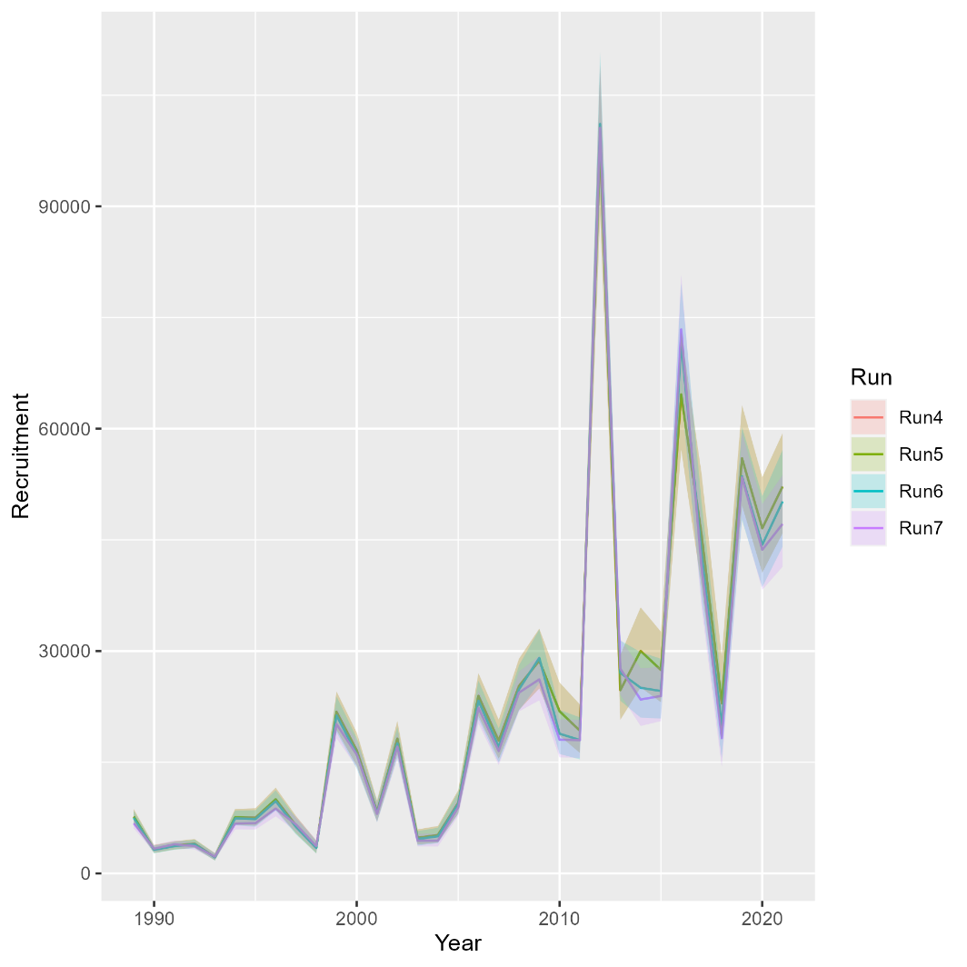
Runs 4-7: Adding maturity, NEAMAP, remaining state indices
Mohn’s rho
Run | F | SSB | Rect
4 | 1.294 | -0.431 | -0.165
5 | 1.294 | -0.431 | -0.165
6 | 1.232 | -0.444 | -0.129
7 | 0.986 | -0.388 | -0.125
North

Slide 10
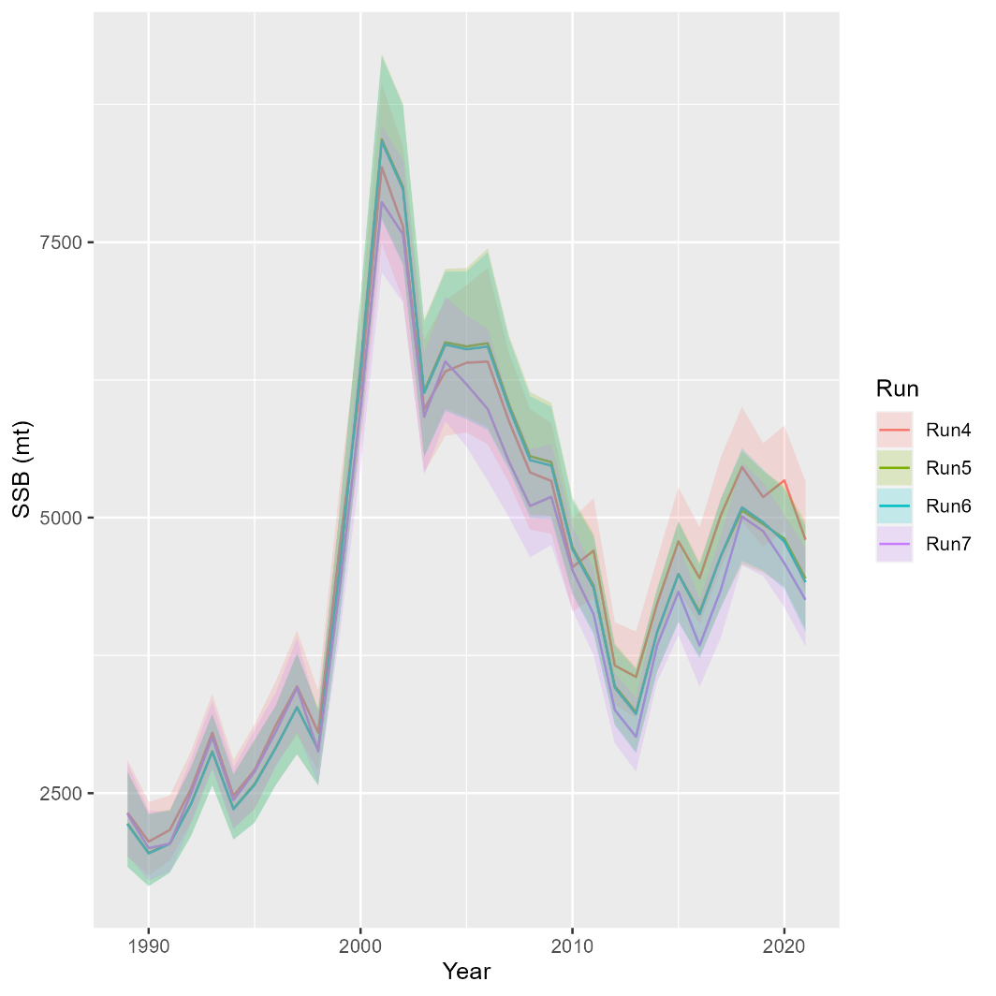
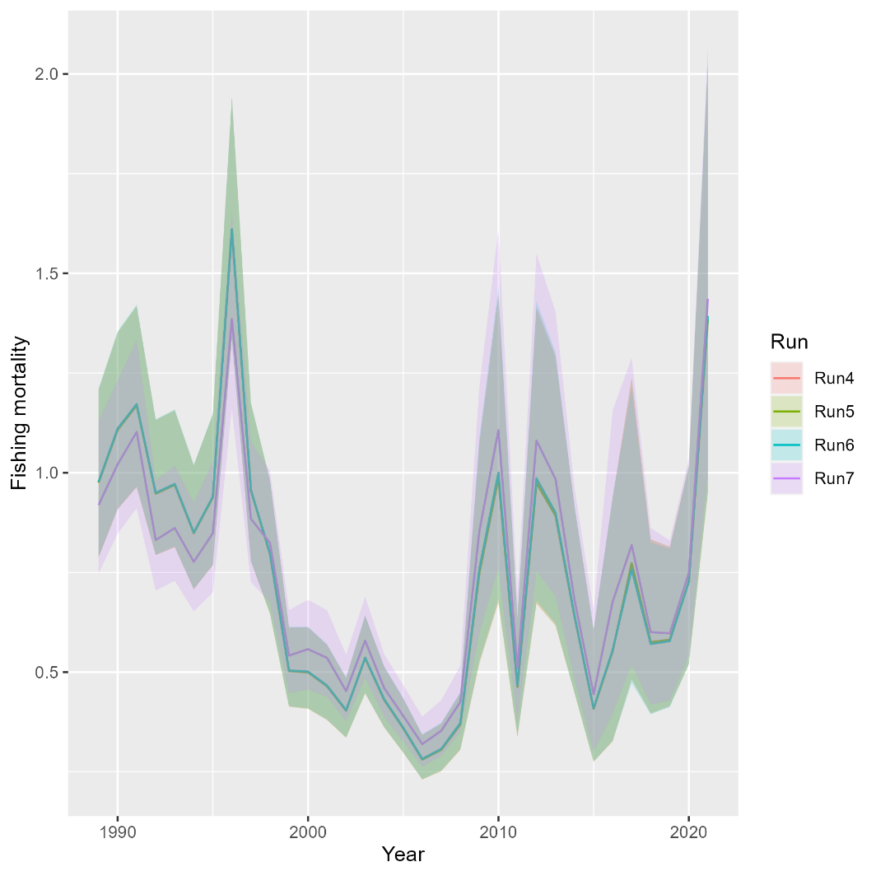
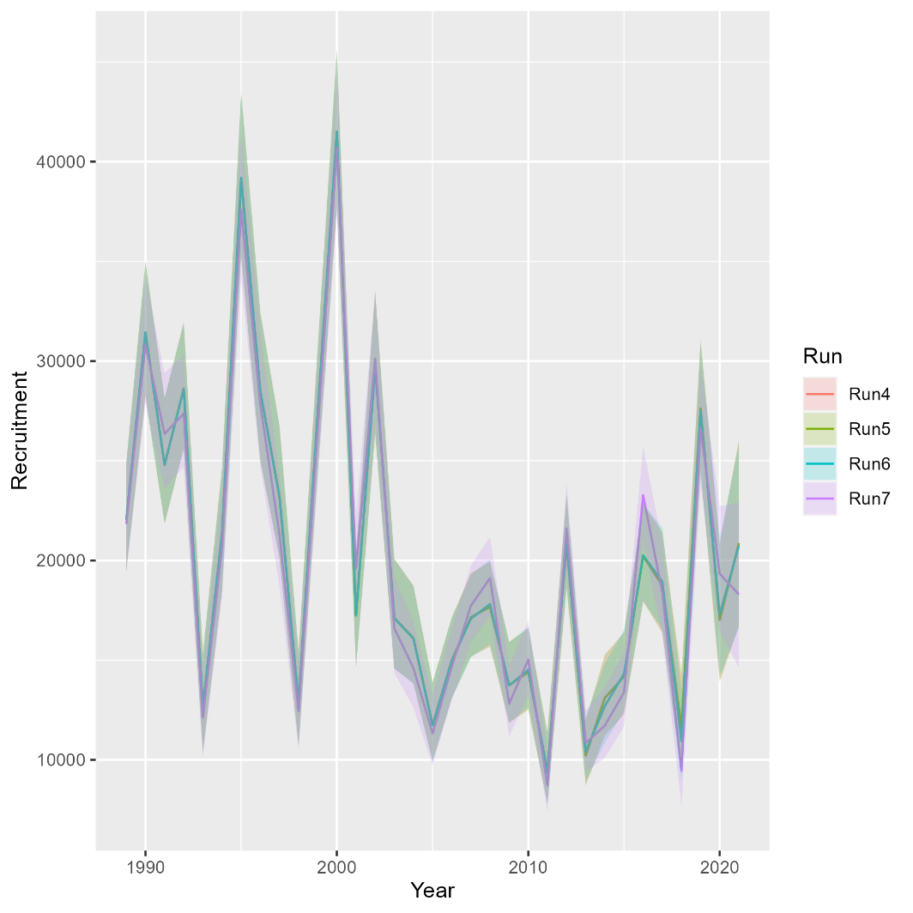
Runs 4-7: Adding maturity, NEAMAP, remaining state indices
Mohn’s rho
Run | F | SSB | Rect
4 | 0.107 | -0.017 | 0.005
5 | 0.107 | -0.015 | 0.005
6 | 0.106 | -0.013 | -0.029
7 | 0.121 | -0.012 | -0.061
South

Slide 11
VAST runs
Run 8: Spring and Fall VAST and RecCPA
Run 9: Spring VAST and RecCPA

Slide 12
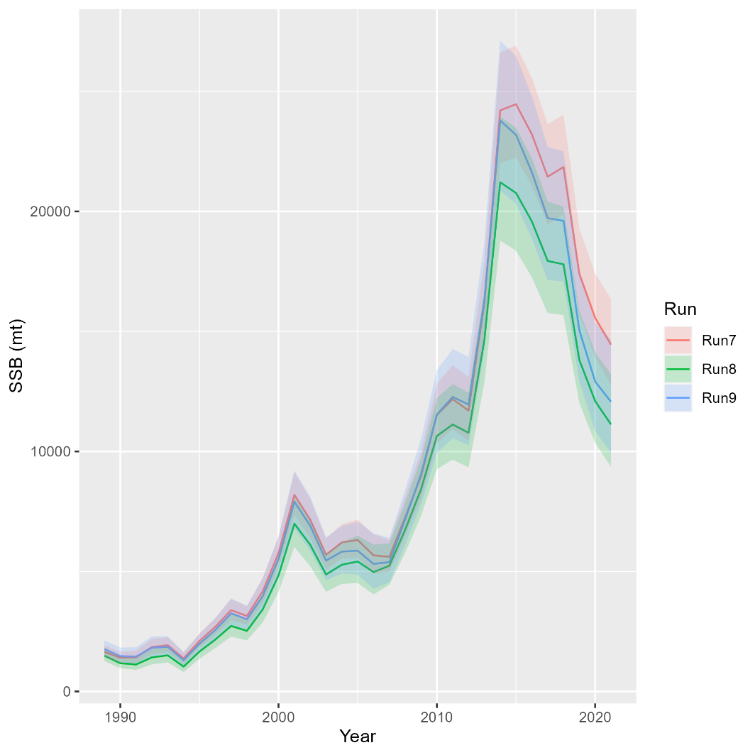
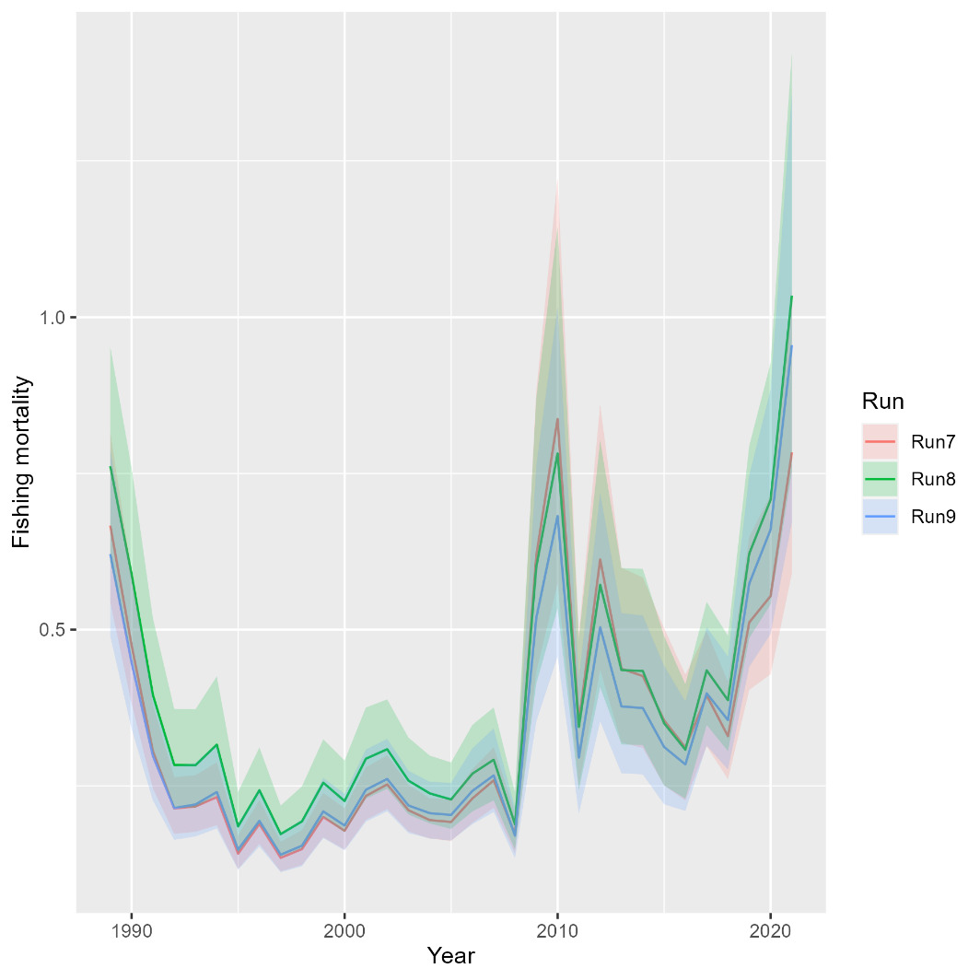
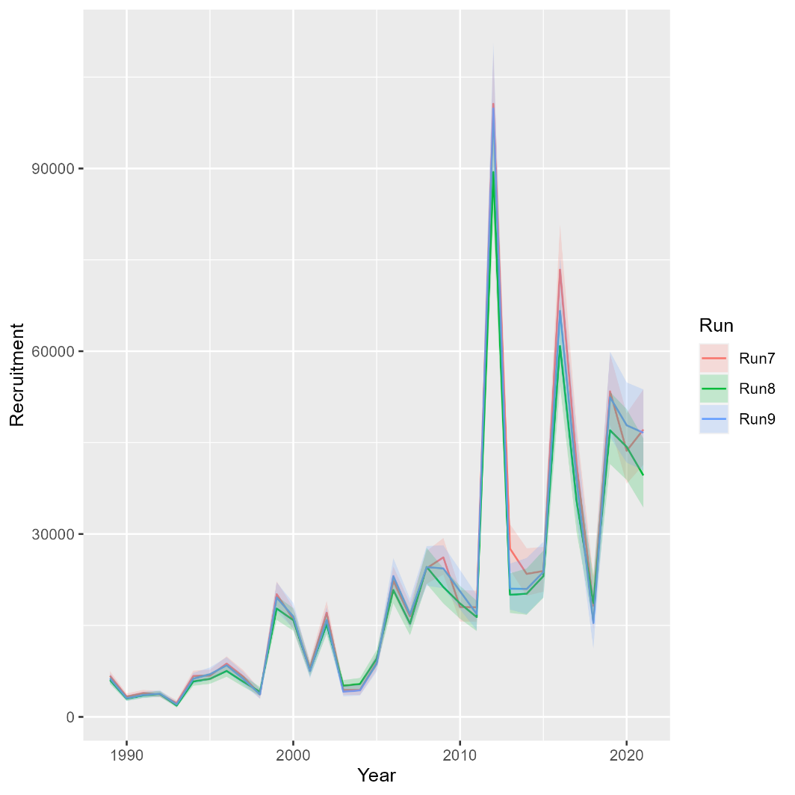
Runs 8-9: Exploring VAST
Mohn’s rho
Run | F | SSB | Rect
7 | 0.986 | -0.388 | -0.125
8 | 1.411 | -0.434 | -0.114
9 | 1.446 | -0.449 | -0.078
North
An error was subsequently discovered in the Fall VAST index, so Run 8 should be ignored

Slide 13
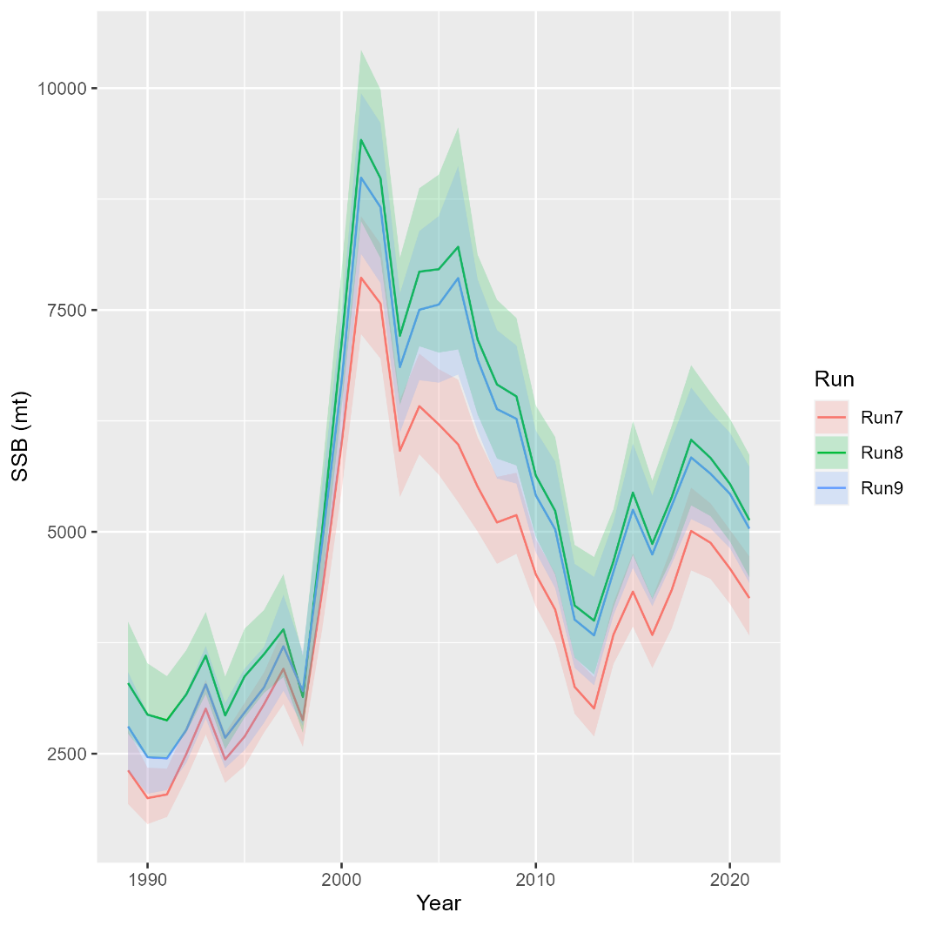
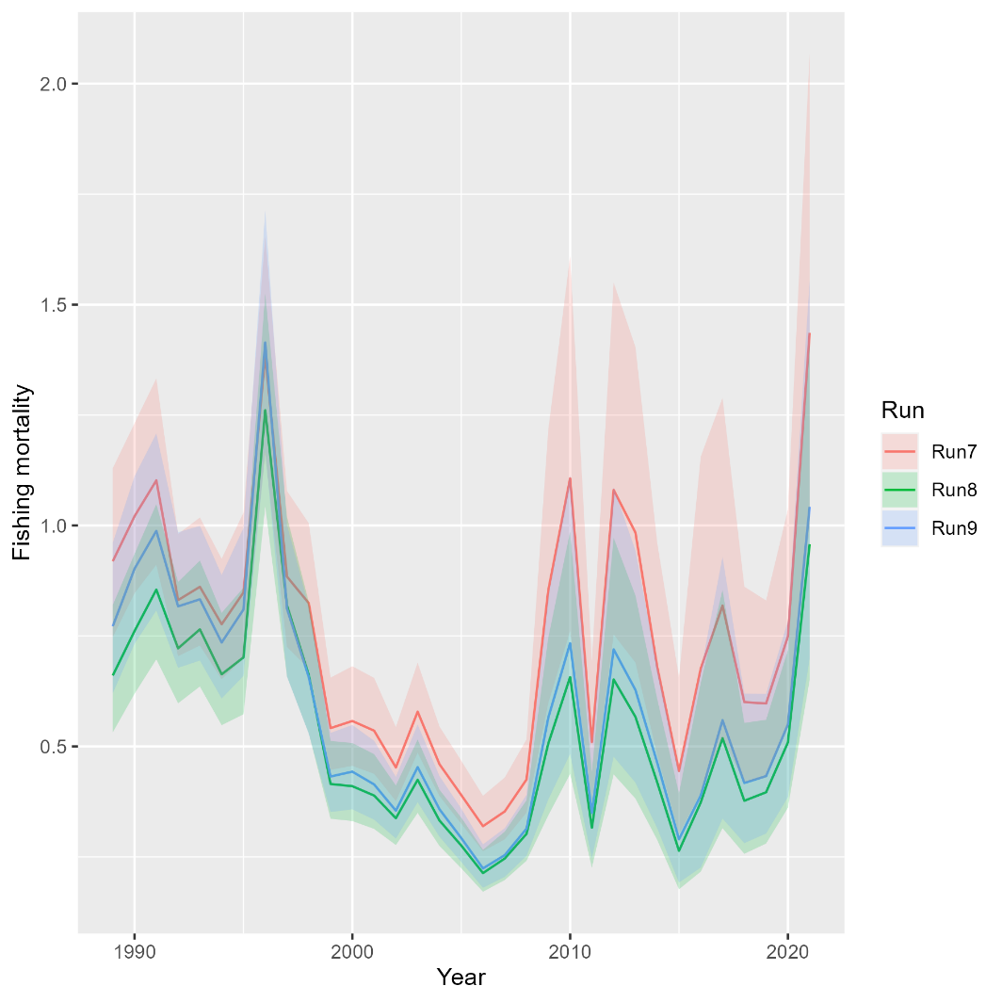
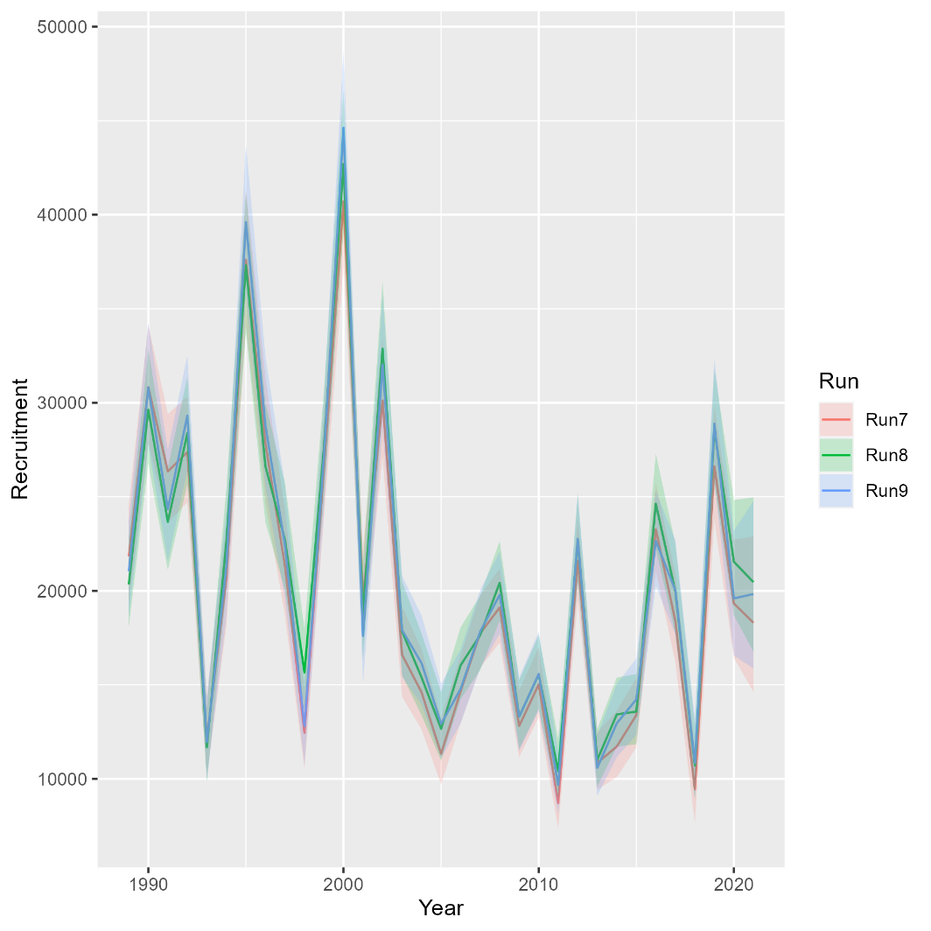
Runs 8-9: Exploring VAST
Mohn’s rho
Run | F | SSB | Rect
7 | 0.121 | -0.012 | -0.061
8 | 0.089 | -0.017 | 0.025
9 | 0.088 | -0.013 | -0.005
South
An error was subsequently discovered in the Fall VAST index, so Run 8 should be ignored

Slide 14
Rec CPA Selectivity
Run 10: Linked Rec CPA selectivity to recreational fishing fleet
**Need to relax this assumption in future iterations

Slide 15
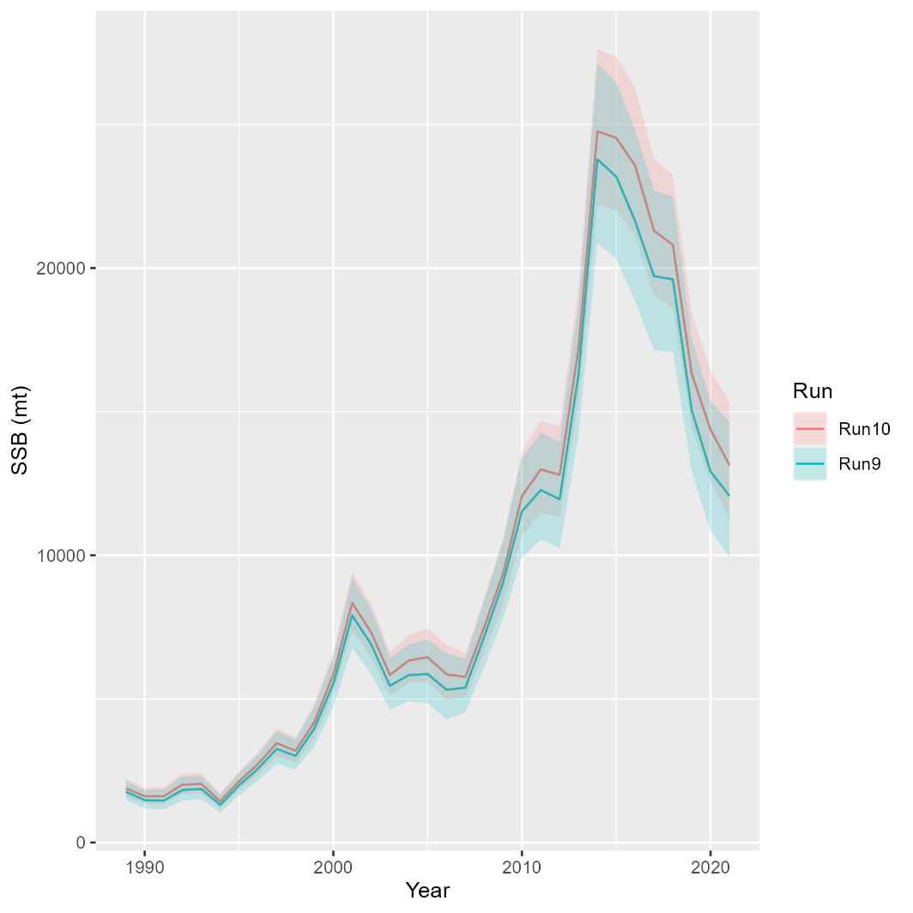
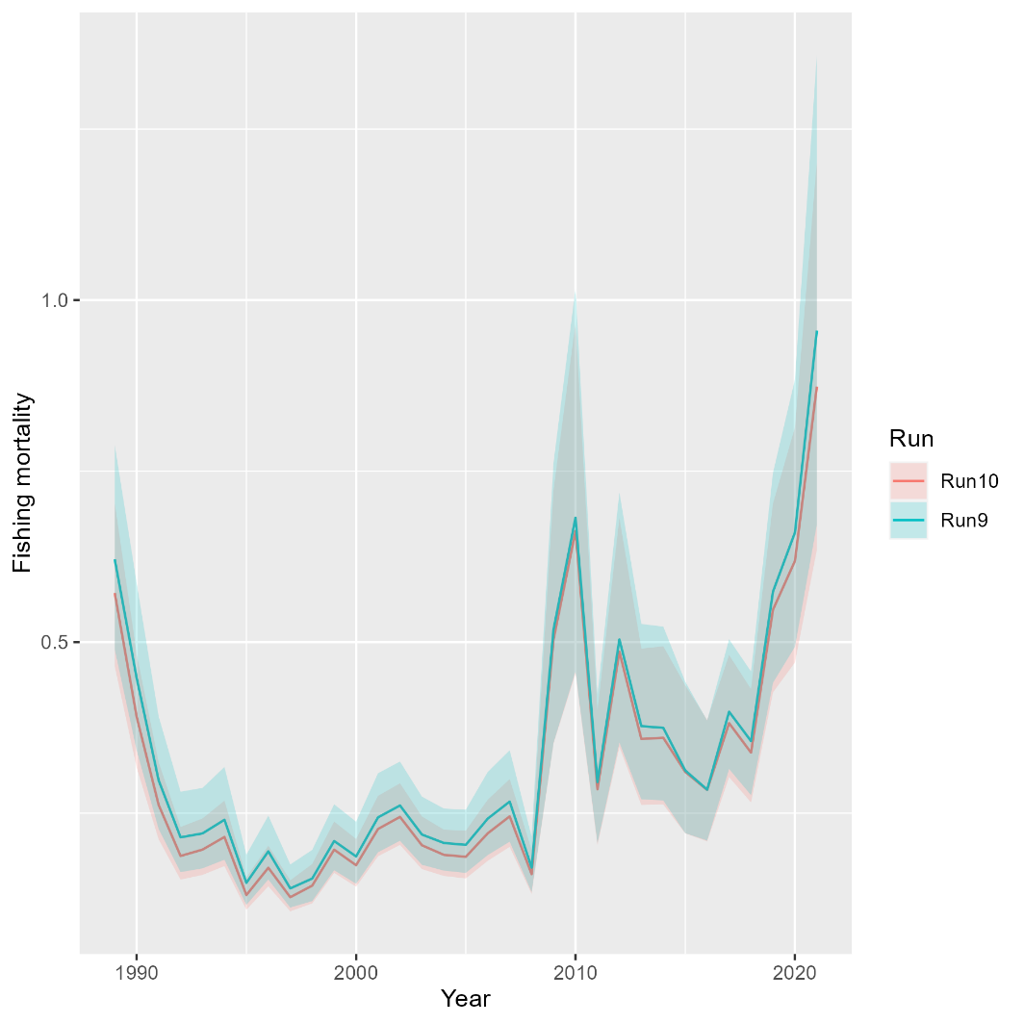
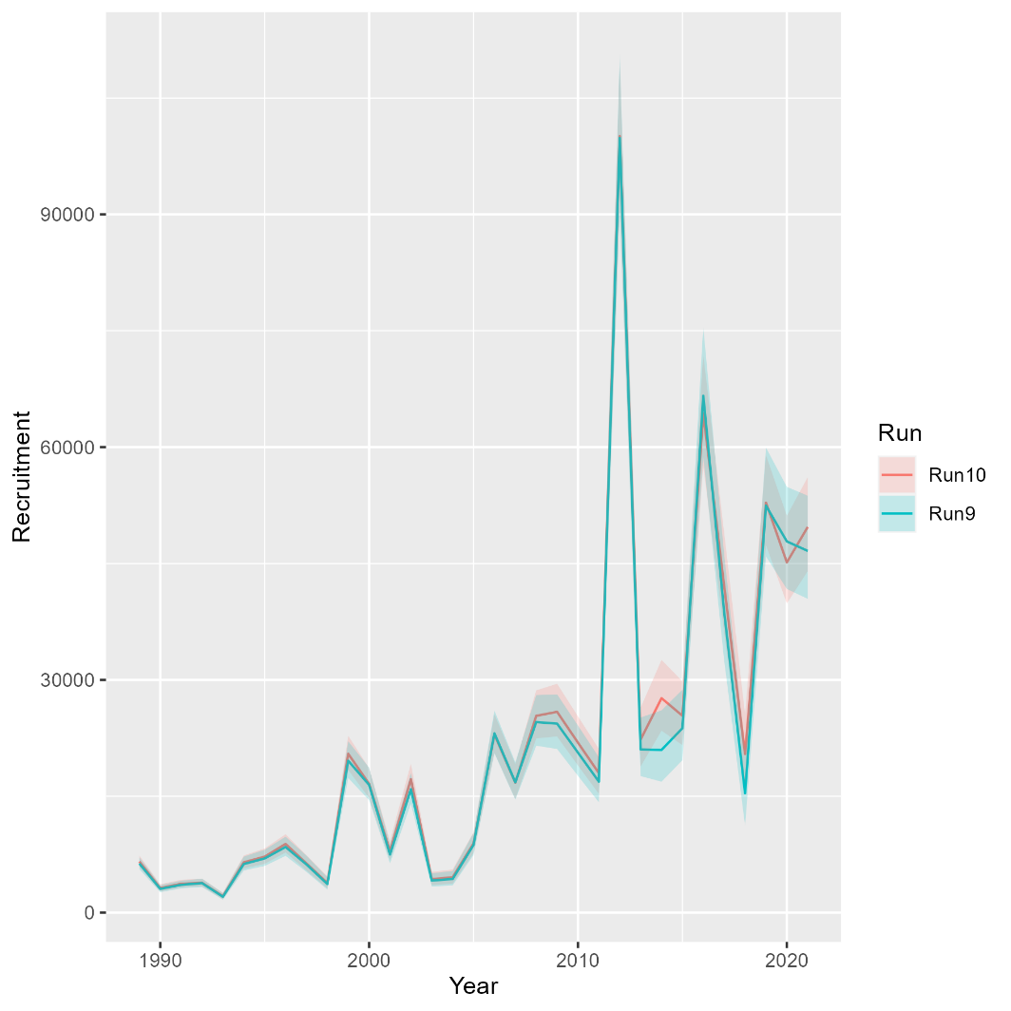
Runs 10: Rec CPA selectivity
Mohn’s rho
Run | F | SSB | Rect
9 | 1.446 | -0.449 | -0.078
10 | 1.235 | -0.408 | -0.122
North

Slide 16
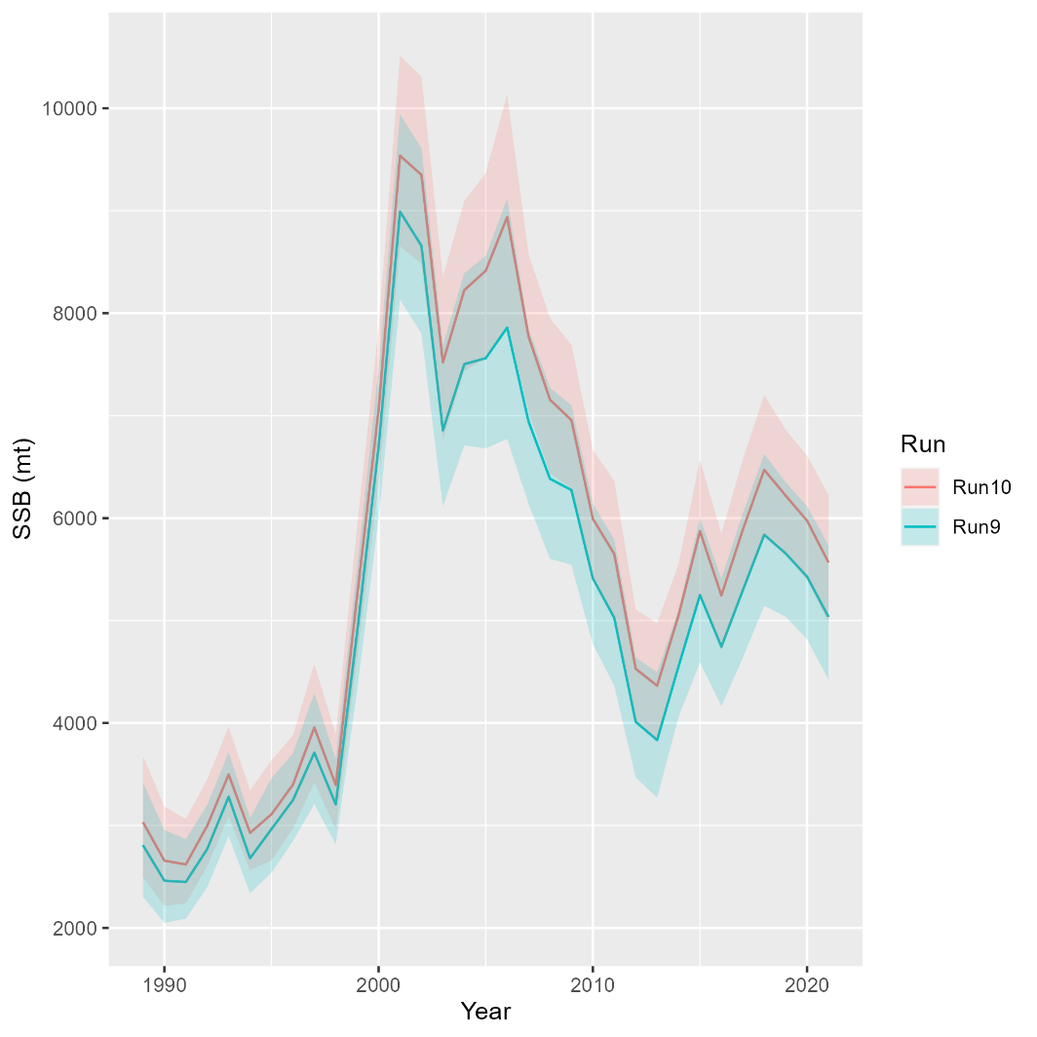
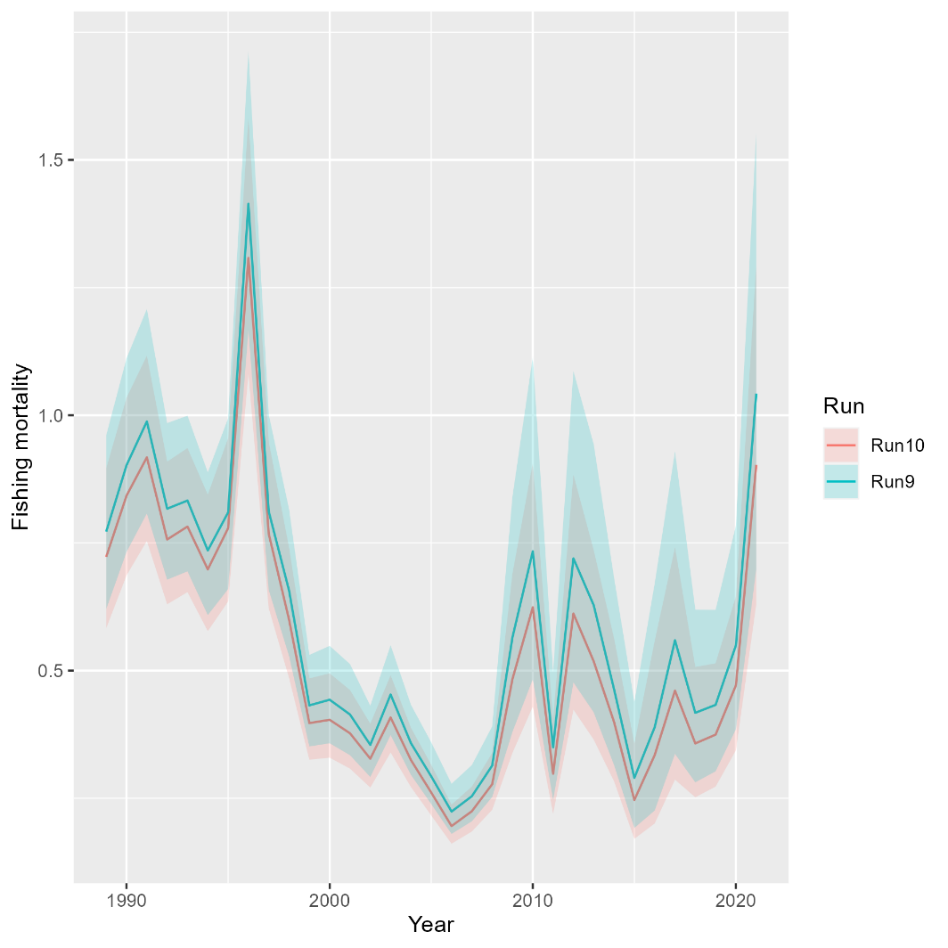
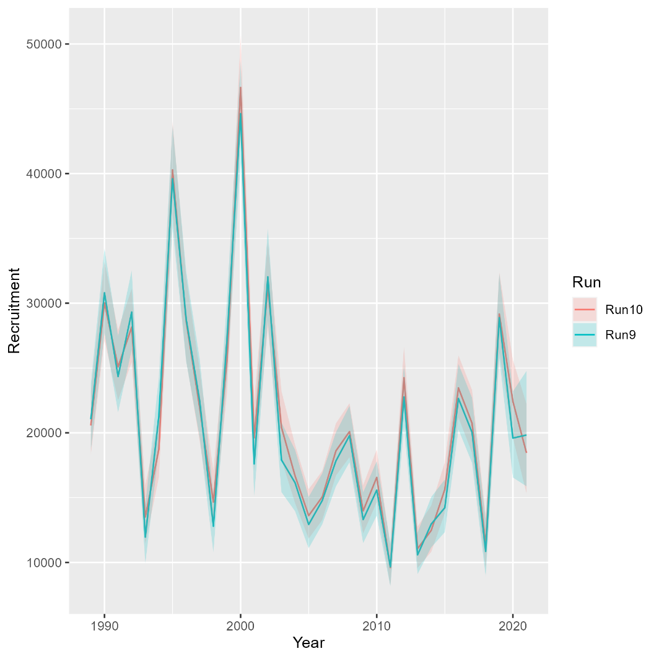
Runs 10: Rec CPA selectivity
Mohn’s rho
Run | F | SSB | Rect
9 | 0.088 | -0.013 | -0.005
10 | 0.106 | -0.032 | -0.04
South

Slide 17
Random effects
Run 11: Random effects (iid) for recruitment and survival

Slide 18
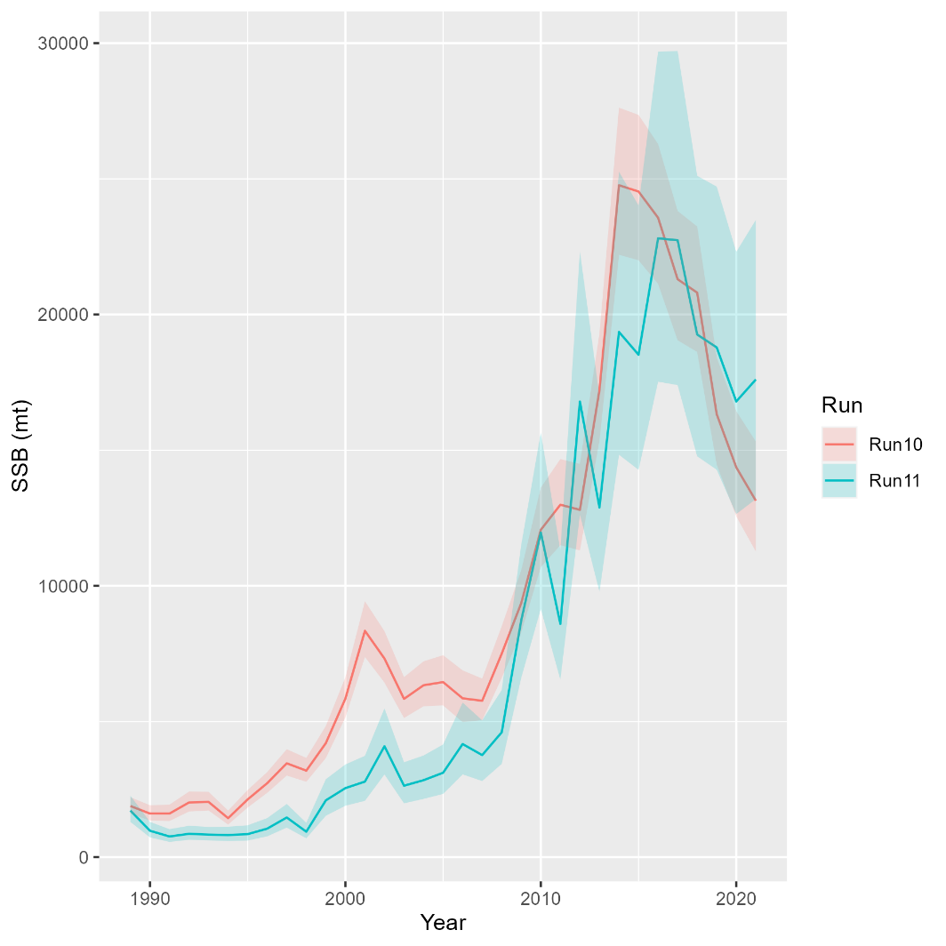
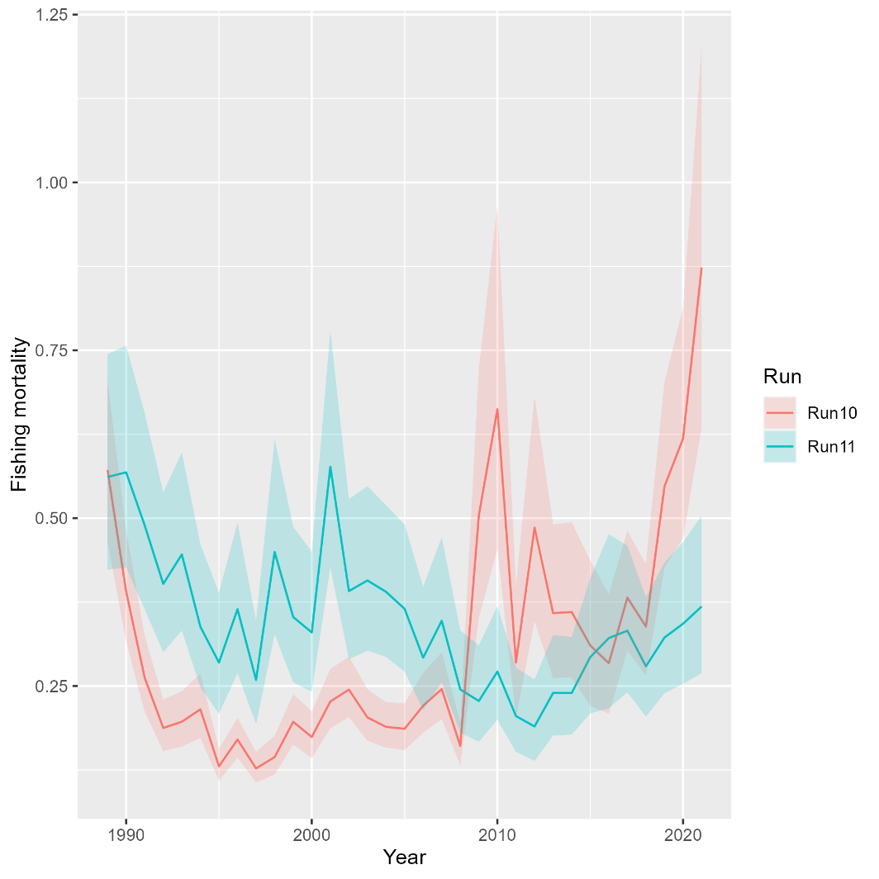
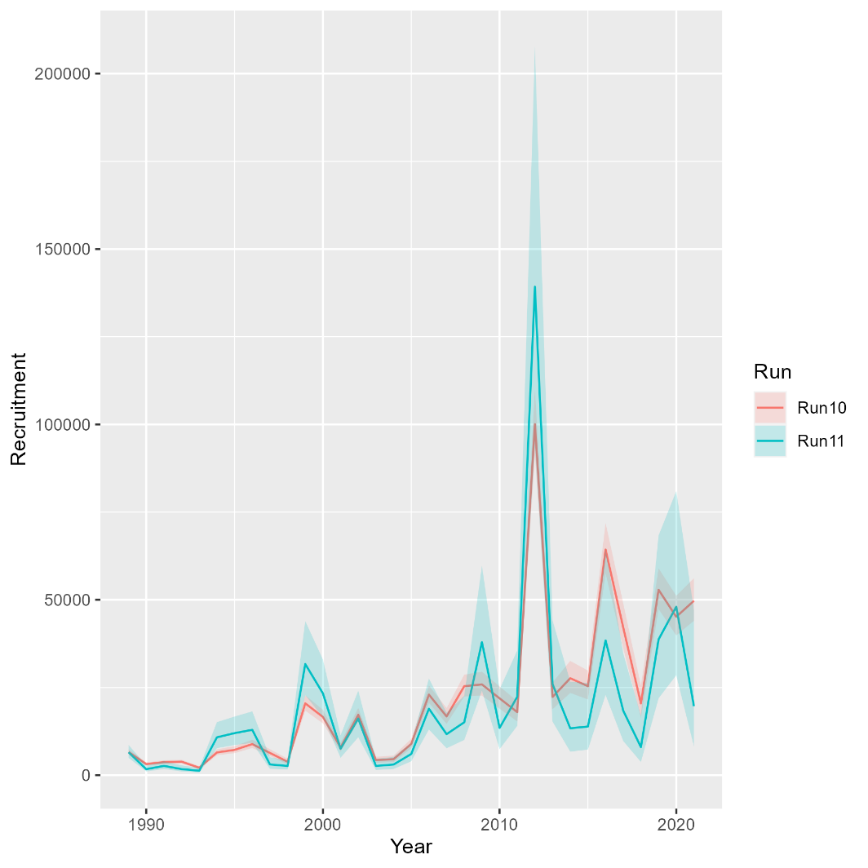
Runs 11: Random effects
Mohn’s rho
Run | F | SSB | Rect
10 | 1.235 | -0.408 | -0.122
11 | 0.144 | -0.128 | -0.188
North

Slide 19
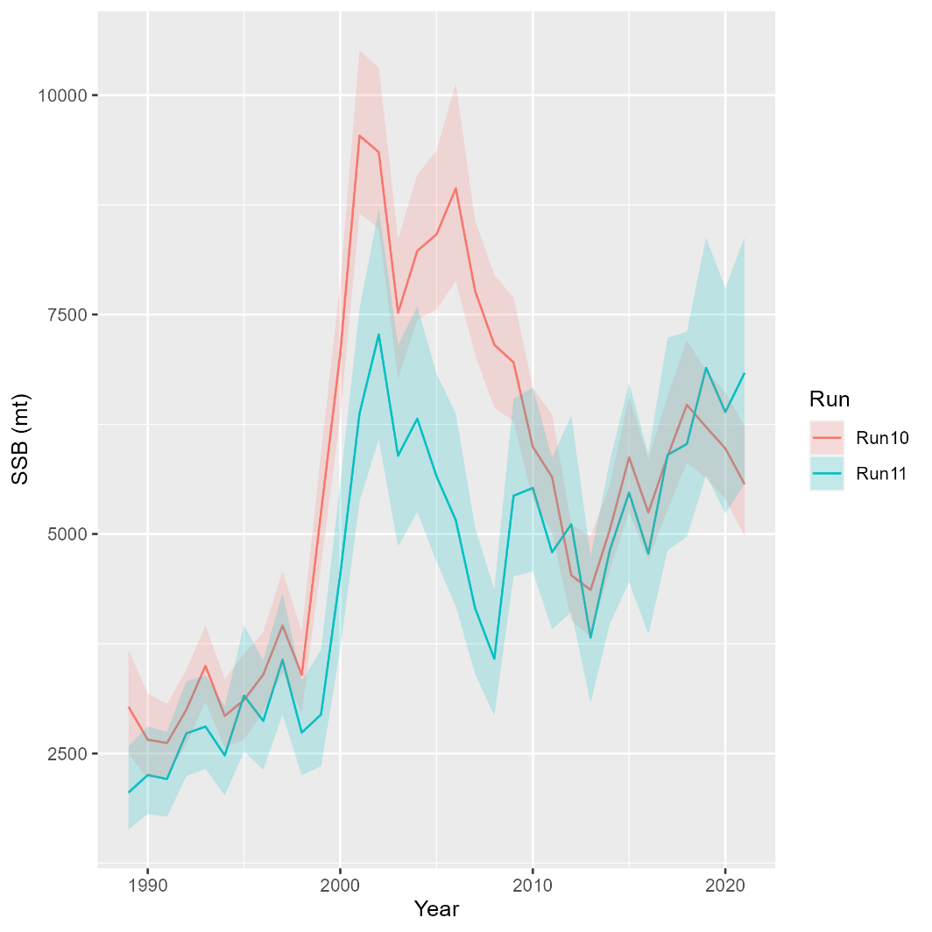
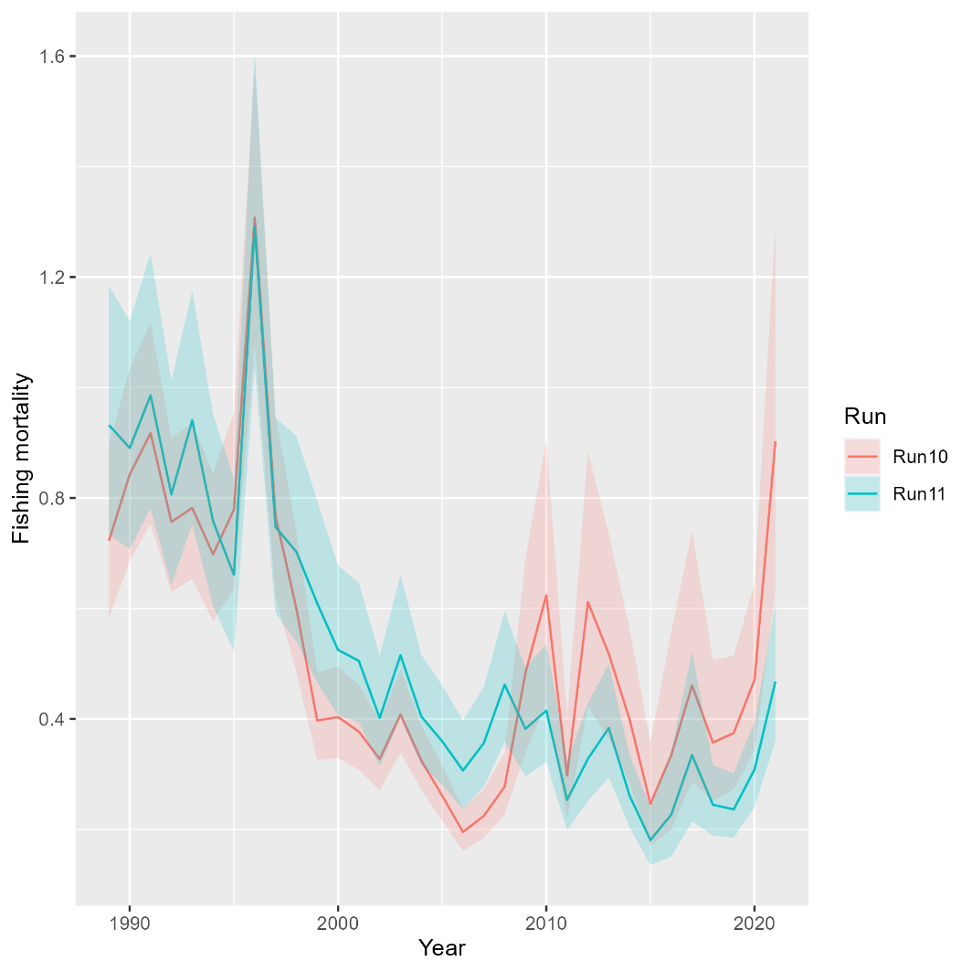
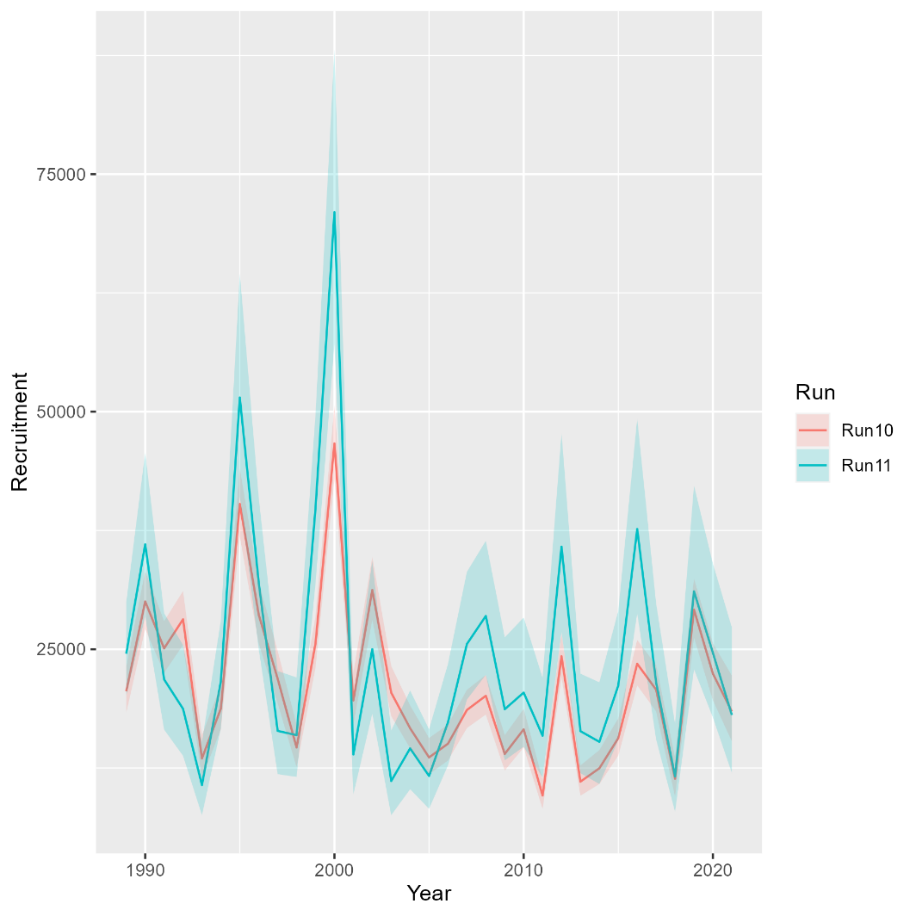
Runs 11: Random effects
Mohn’s rho
Run | F | SSB | Rect
10 | 0.106 | -0.032 | -0.04
11 | -0.005 | -0.017 | -0.006
South

Slide 20
Movement
Run 12: Mixing with movement rate fixed at 0.1
Run 13: Add prior to movement rate at 0.1
Run 14: Switch to logistic normal for age comps
Runs that did not converge:
Run 15: Estimate SD scalar for aggregate Rec CPA
Run 16: Add AR1 on north-to-south movement

Slide 21
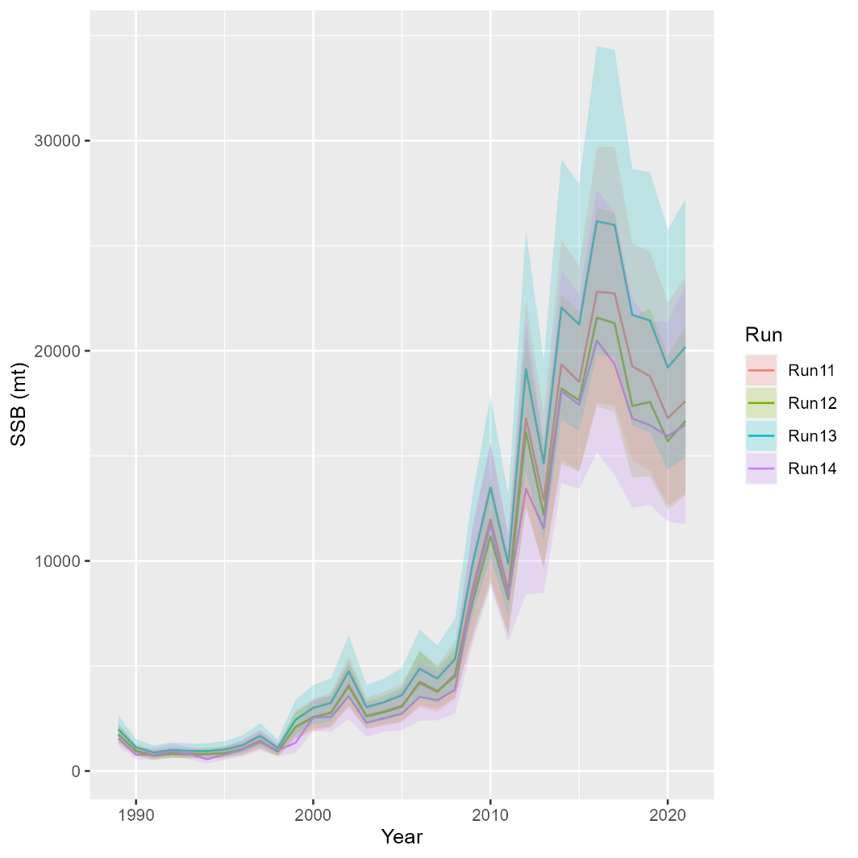
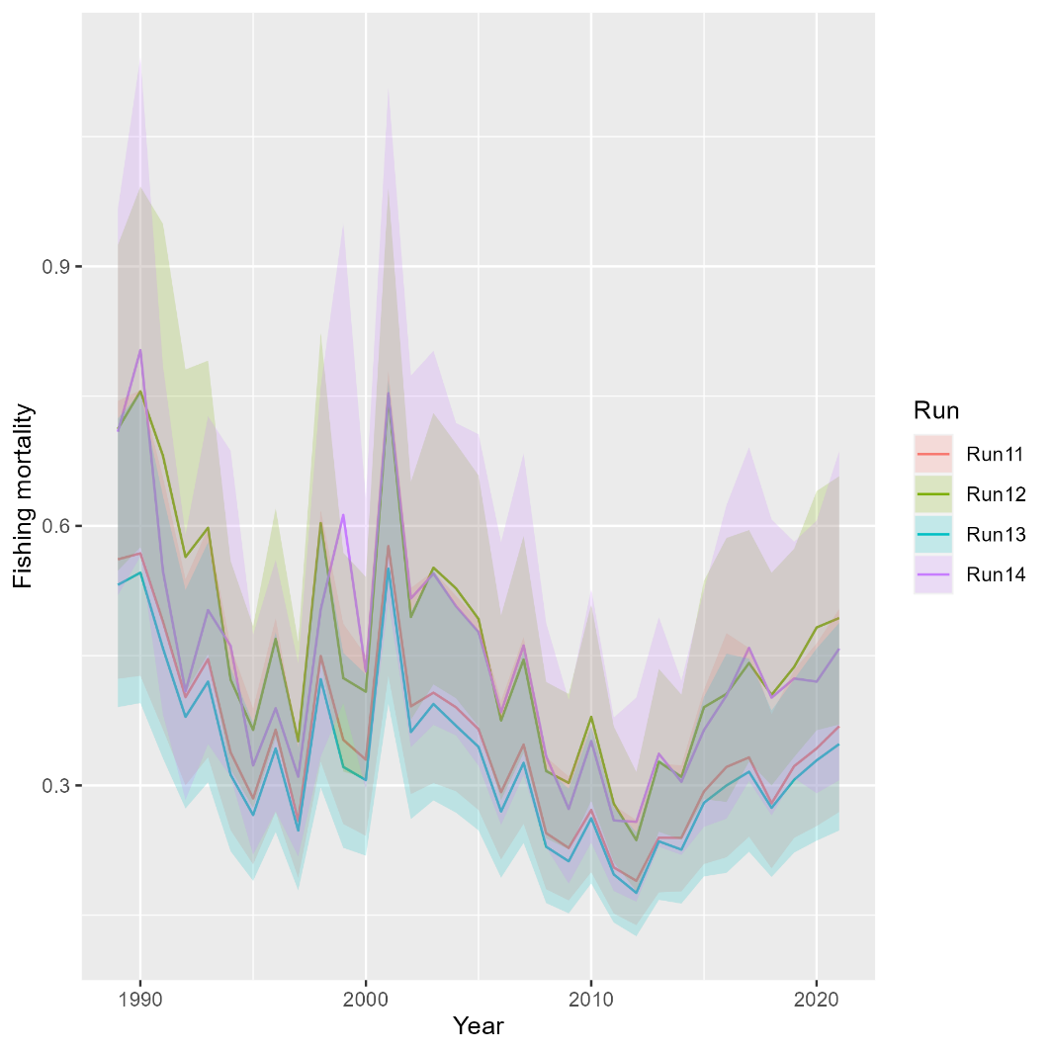
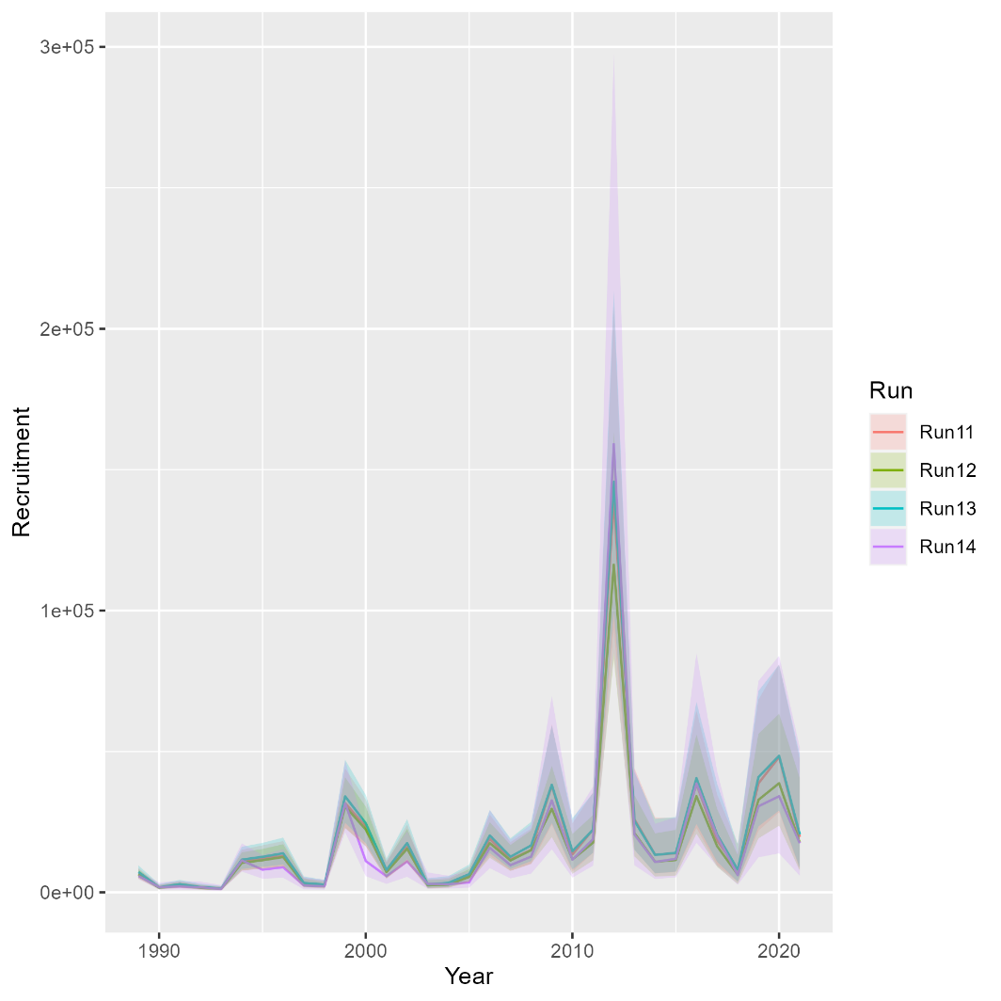
Runs 12-14: Movement
Mohn’s rho
Run | F | SSB | Rect
11 | 0.144 | -0.128 | -0.188
12 | 0.05 | -0.046 | -0.122
13 | 0.172 | -0.151 | -0.205
14 | 0.14 | -0.071 | -0.356
North

Slide 22
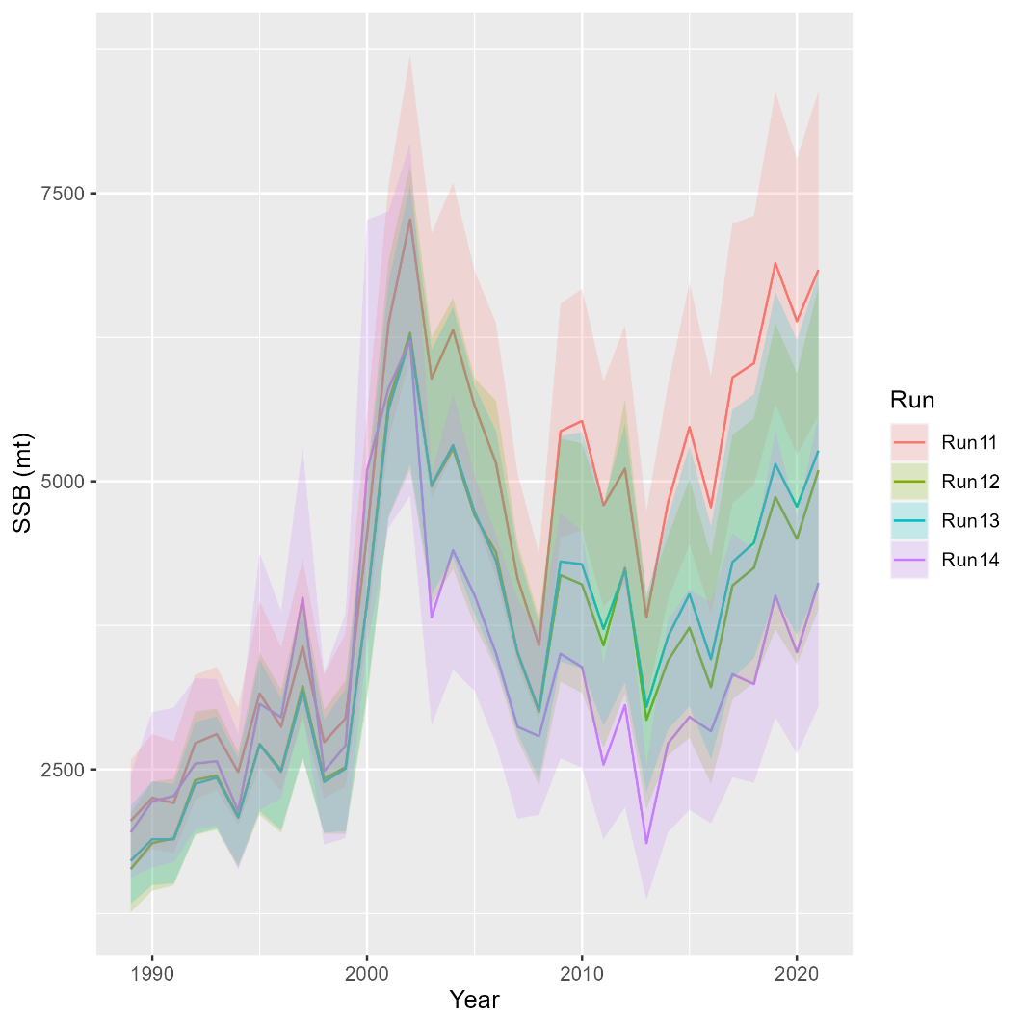
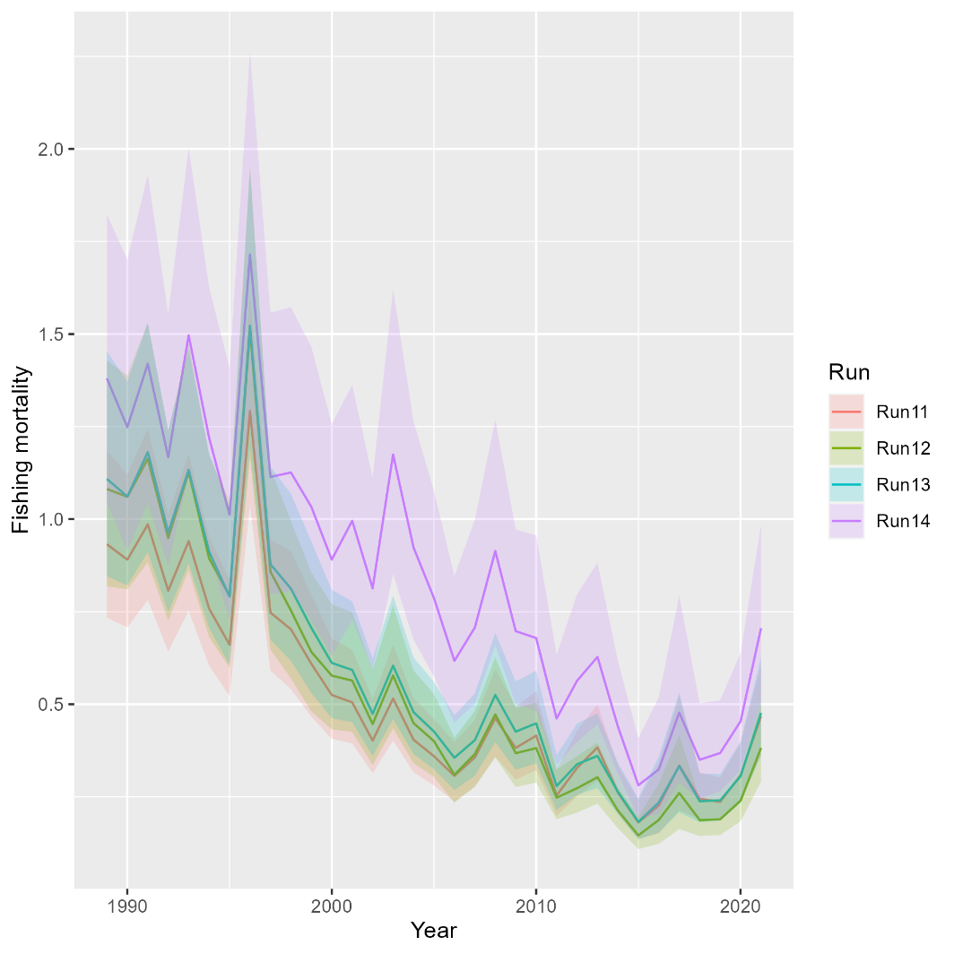
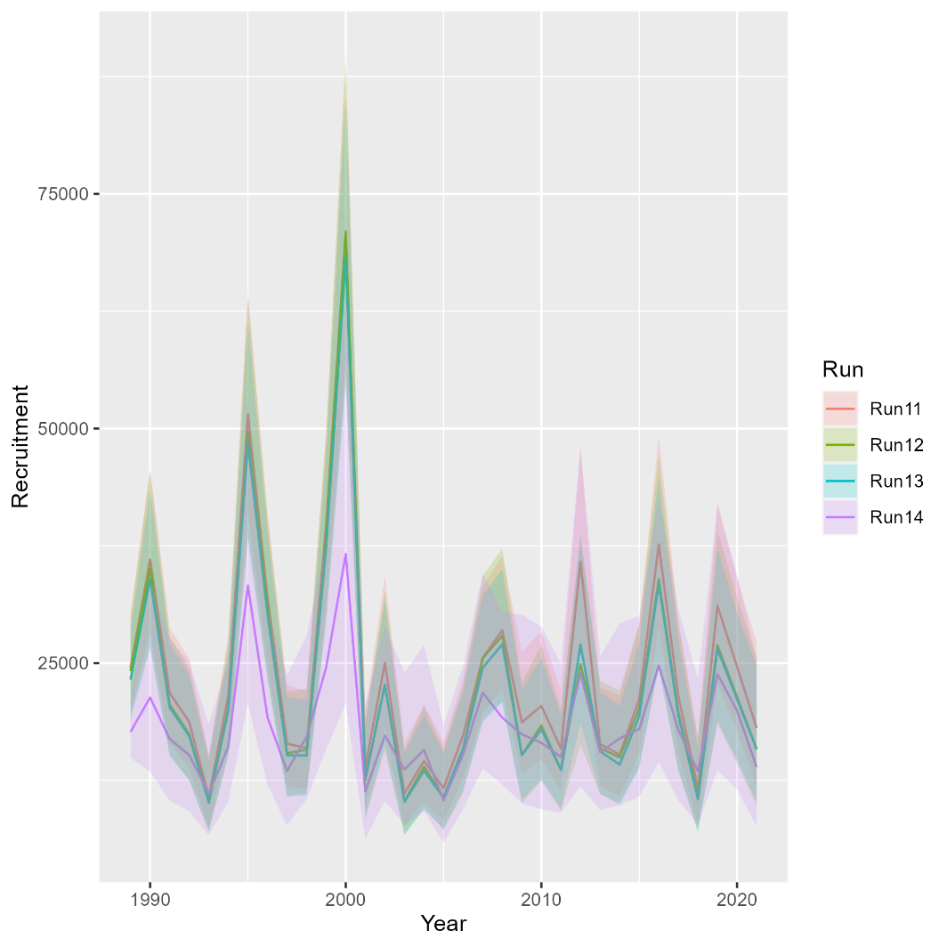
Runs 12-14: Movement
Mohn’s rho
Run | F | SSB | Rect
11 | -0.005 | -0.017 | -0.006
12 | 0.028 | -0.028 | 0.014
13 | -0.031 | 0.07 | 0.018
14 | -0.082 | -0.006 | -0.003
South

Slide 23
On the horizon….
Separate RecCPA selectivity from recreational fishing fleet
….

